Slide 1
Presentation 3: Example Software Architectures
James Martin
CpE 691, Spring 2010
February 11, 2010

Slide 2
Projects
Document Filter System (DFS) G. Zhao, D. Liu, H. Song, and C. Zou, “Software architecture design and implementation of document filter system," Computational Intelligence and Natural Computing, International Conference on, vol. 1, pp. 309{312, 2009. [Online]. Available: http://dx.doi.org/http://doi.ieeecomputersociety.org/10.1109/CINC.2009.143
Reference Architecture for E-Government (RAfEG) D. Beer, R. Kunis, and G. Runger, “A component based software architecture for e-government applications,” Availability, Reliability and Security, International Conference on, vol. 0, pp. 1004–1011, 2006. [Online]. Available: http://dx.doi.org/http://doi.ieeecomputersociety.org/10.1109/ARES.2006.3

Slide 3
What to expect
DFS
Decent job of describing a software architecture at varying levels
Lacks detail
RAfEG
Emphasizes the domain specific attributes / functionality of the application
Only provides a top level software architecture
Does not emphasize architecture

Slide 4
Projects
Document Filter System (DFS) G. Zhao, D. Liu, H. Song, and C. Zou, “Software architecture design and implementation of document filter system," Computational Intelligence and Natural Computing, International Conference on, vol. 1, pp. 309{312, 2009. [Online]. Available: http://dx.doi.org/http://doi.ieeecomputersociety.org/10.1109/CINC.2009.143
Reference Architecture for E-Government (RAfEG) D. Beer, R. Kunis, and G. Runger, “A component based software architecture for e-government applications,” Availability, Reliability and Security, International Conference on, vol. 0, pp. 1004–1011, 2006. [Online]. Available: http://dx.doi.org/http://doi.ieeecomputersociety.org/10.1109/ARES.2006.3

Slide 5
DFS – Problem
How to find interesting information or documents fast for a user has been a hot problem needed to be solved
…researchers have proposed lots of good algorithms and solutions; however, what we see these just implementing some function, or some models and it is not the whole system framework.
There is not a friendly application system for filtering documents with the whole system architecture.

Slide 6
DFS – Goals / Requirements
Support different researchers’ application in different disciplines.
Support searching operations for Chinese and English documents.
Support complex query function with muticonditions.
Support the parsing for different type of documents, such as PDF, TXT, DOC, and HTML etc.
Convenient to operate for users.

Slide 7
DFS – Goals / Requirements (2)
Multiplicity: Supports each kind of documents;
Flexibility: Supports the combination during searching
Universality: Suits each kind of different crowd to use
Friendliness: Provides the historical record and also

Slide 8
DFS – System Level Pattern
Model / View / Controller (MVC)
Did not give any rational for using this pattern

Slide 9
System Architecture Design
Top-layer use case diagram
“User” is the only participant
User can perform registration, login, information import and information inquiry
Information import involves importing documents, parsing documents and inputing query information
There are two types of information inquiries: advanced and regular

Slide 10
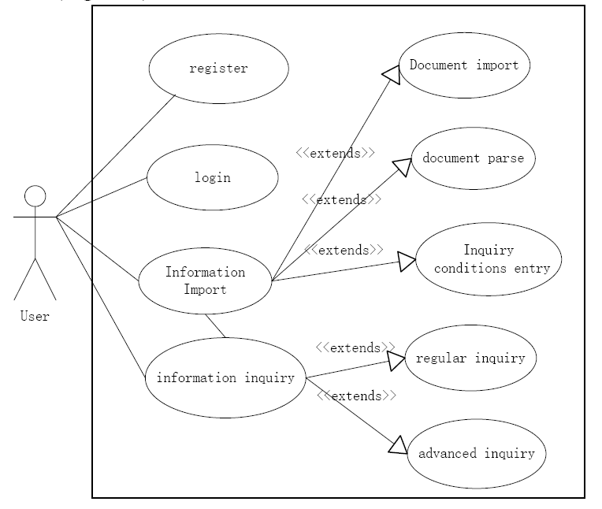
DFS - Top-layer use case diagram

Slide 11
DFS – Top Level Modules
Simple list of classes
Class User: class for the user
Class DocumentParse: class for file parsing
Class DataBaseObject: class for operating database
Class PublicOperation: class for the public operation
Class QueryRequest: class for requiring

Slide 12
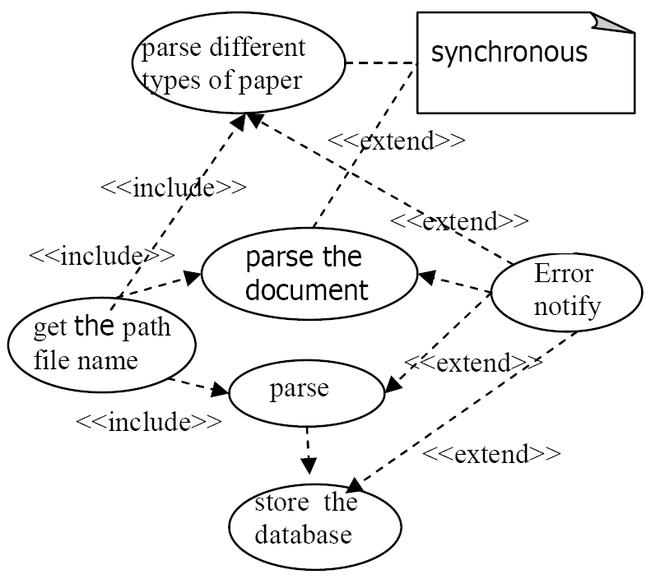
DFS – Parse Use Case Diagram

Slide 13
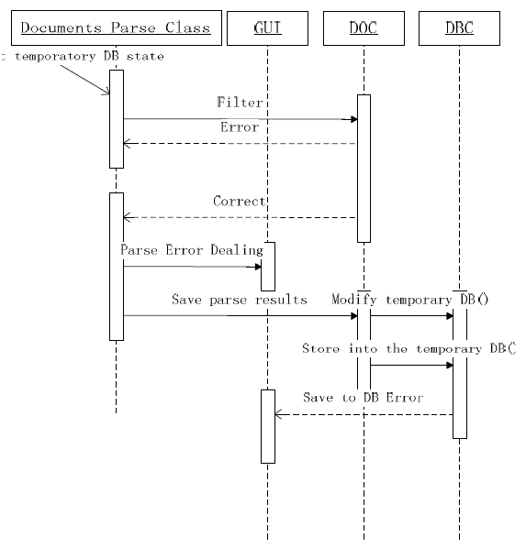
DFS –Parse Sequence Diagram

Slide 14
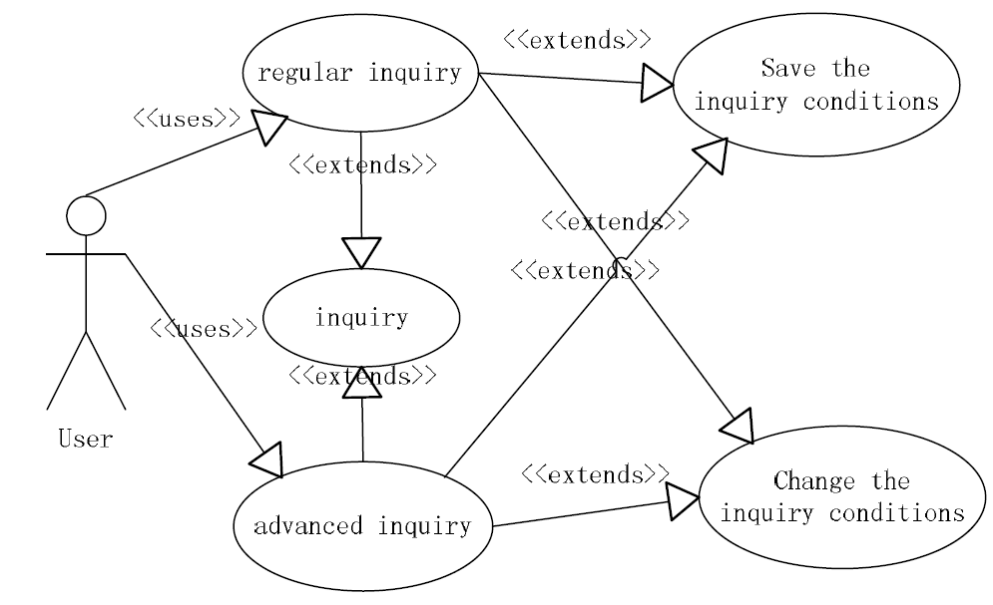
DFS – Query Use Case Diagram

Slide 15
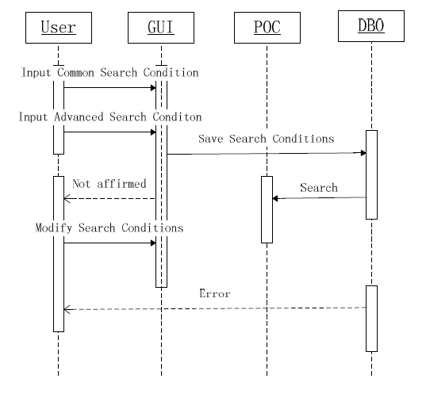
DFS – Query Sequence Diagram

Slide 16
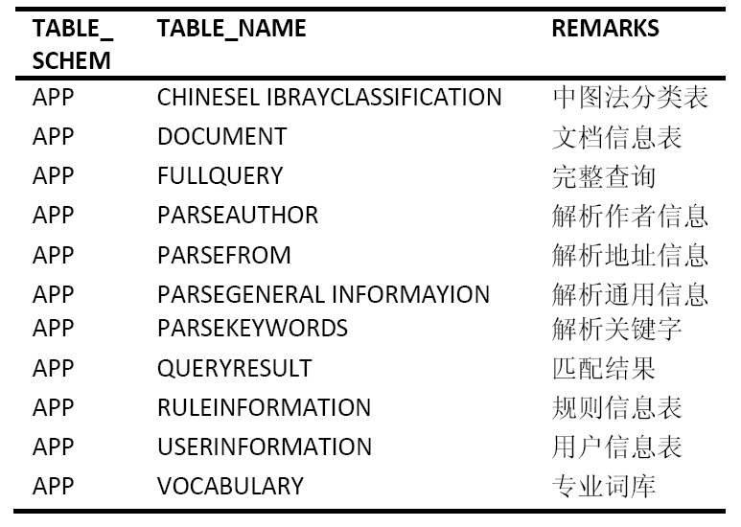
DFS – Database Design
Only a list of tables was given

Slide 17
DFS - Implementation
Languages: Java and C++
Tooling: Eclipse
Searching: Apache Lucene
PDF Import: PDF Box
HTML and RTF Import: Java Swing
MS Word Import: Tm-extractor
Database: Apache Derby 10.2

Slide 18
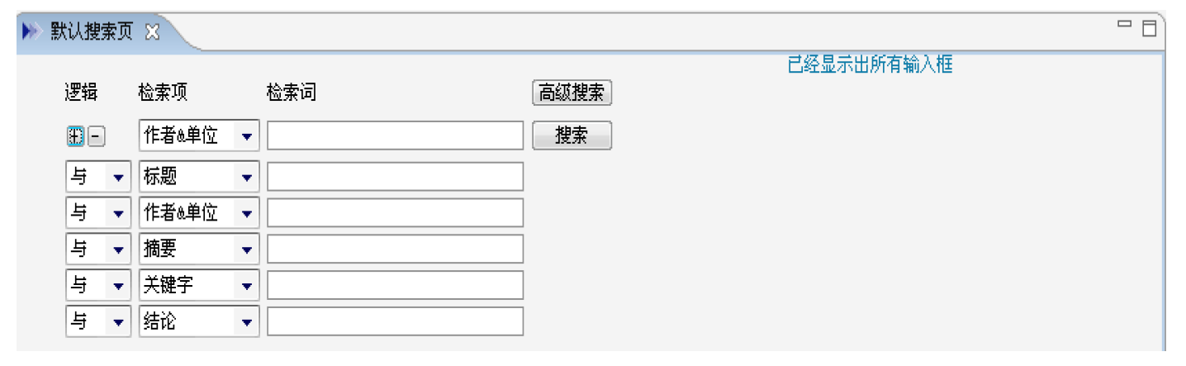
DFS – Query Input GUI

Slide 19
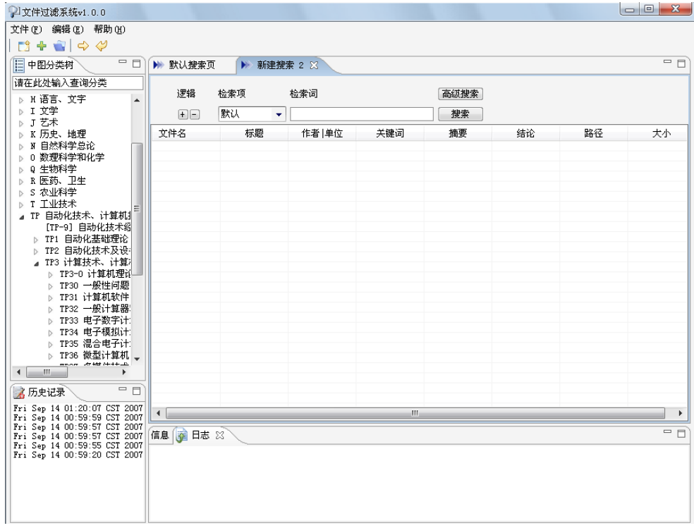
DFS – Whole System GUI

Slide 20
Projects
Document Filter System (DFS) G. Zhao, D. Liu, H. Song, and C. Zou, “Software architecture design and implementation of document filter system," Computational Intelligence and Natural Computing, International Conference on, vol. 1, pp. 309{312, 2009. [Online]. Available: http://dx.doi.org/http://doi.ieeecomputersociety.org/10.1109/CINC.2009.143
Reference Architecture for E-Government (RAfEG) D. Beer, R. Kunis, and G. Runger, “A component based software architecture for e-government applications,” Availability, Reliability and Security, International Conference on, vol. 0, pp. 1004–1011, 2006. [Online]. Available: http://dx.doi.org/http://doi.ieeecomputersociety.org/10.1109/ARES.2006.3

Slide 21
RAfEG - Problem
Official procedures are associated with a lot of paperwork…
…in many cases more than one employee is involved
…many official procedures are not restricted to a single authority, leading to the need for distributed execution…
A system is required that will allow for the sharing procedural tasks and the documents that go with them

Slide 22
RAfEG – Goals / Requirements
…design of a suitable e-government solution based on workflows…according to modern standards for open source software.
Should be executable on all established operating systems
Should be easy to expand and adapt
Distribution of system components on heterogeneous platforms as well as the distributed execution of official procedures should be possible

Slide 23
RAfEG - Goals / Requirements (2)
Security features should allow a highly secure system by using up-to-date security software solutions and protocols
Nonelectronic communication should be supported
Various output formats like HTML pages, PDF documents and WML (Wireless Markup Language) pages should be supported
New output formats should be easy to add
Third party software should be free and easily exchangeable

Slide 24
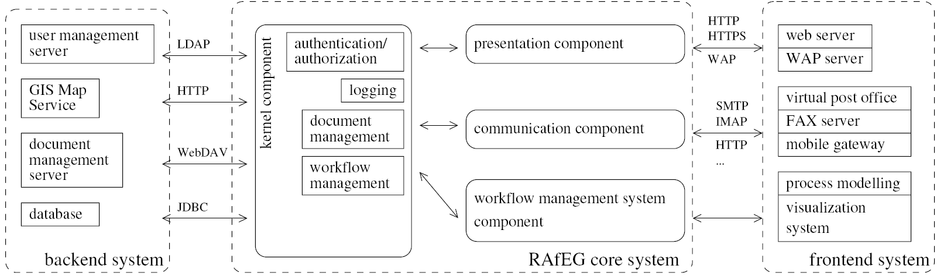
RAfEG – Top Level System Structure

Slide 25
RAfEG – Core System Components
Kernel Component
Workflow Management Component
Communication Component
Presentation Component

Slide 26
RAfEG - Kernel Component
Performs
Authentication
Authorization
Logging
Document Management
Workflow Management

Slide 27
RAfEG - Workflow Management Component
Provisions methods to access worklists
Integrate new procedures modeled as workflows and updates existing ones
Start workflows
Accepts, executes and completes tasks by employees

Slide 28
RAfEG - Communication Component
Manages communication between
Multiple RAfEG core systems
RAfEG and other governmental systems
Allows for nonelectronic communication (extraction, import)

Slide 29
RAfEG – Other Components
Presentation Components: Handles dynamic generation of the user interface
Frontend Components: provider interactive web-based user interface
Backend Components:
User management
GIS map services
Document management
Database

Slide 30
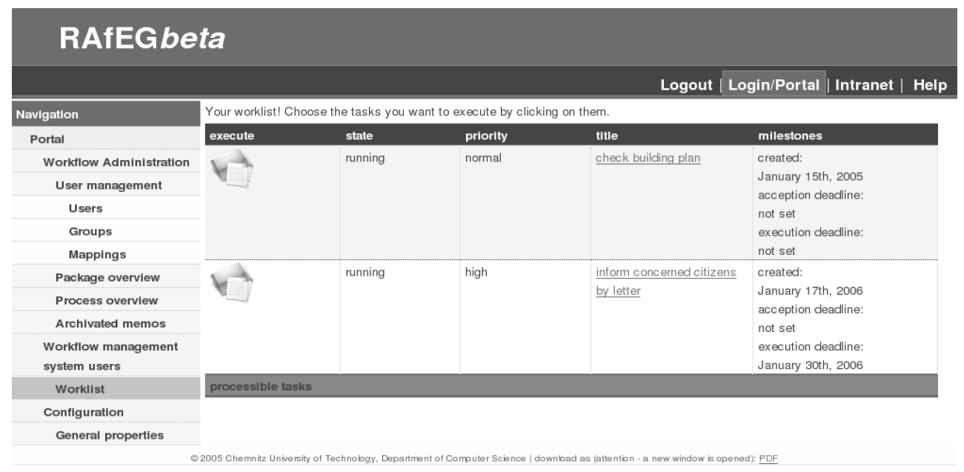
RAfEG – Worklist in a web browser

Slide 31
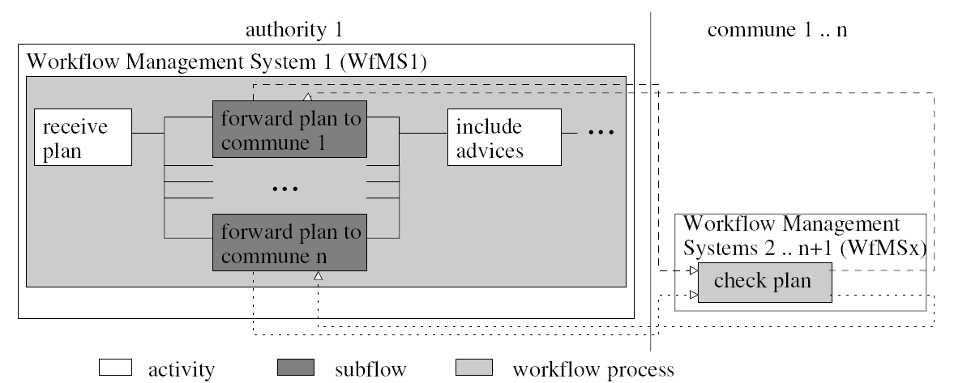
RAfEG – Workflow Example

Slide 32
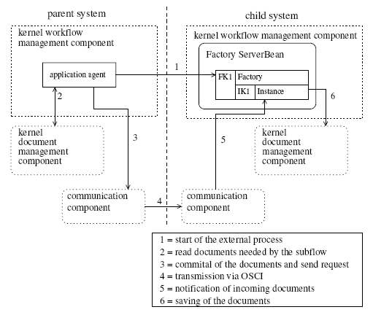
RAfEG – Starting an external subflow

Slide 33
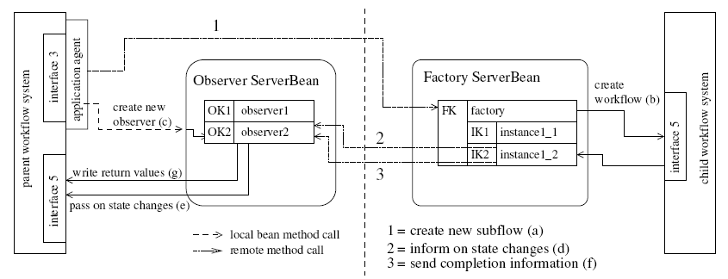
RAfEG – Executing an external subflow

