Slide 1
Assignment 1 due Today
Turn it into my mailbox in White 111 if you don’t have it right now.
Printed copy please.
Assignment 2 is due October 7.
Choices (Submit in any order):
Guided “Learning How You Learn” Reflection
Three-Part Assignment: AI, Learning, and Finding Reliable Sources
Physics Career Exploration Assignment
Now that you’ve hopefully read these, any questions on any of them?
Notes:
Don’t forget to remove the LSMO/AI example

Slide 2
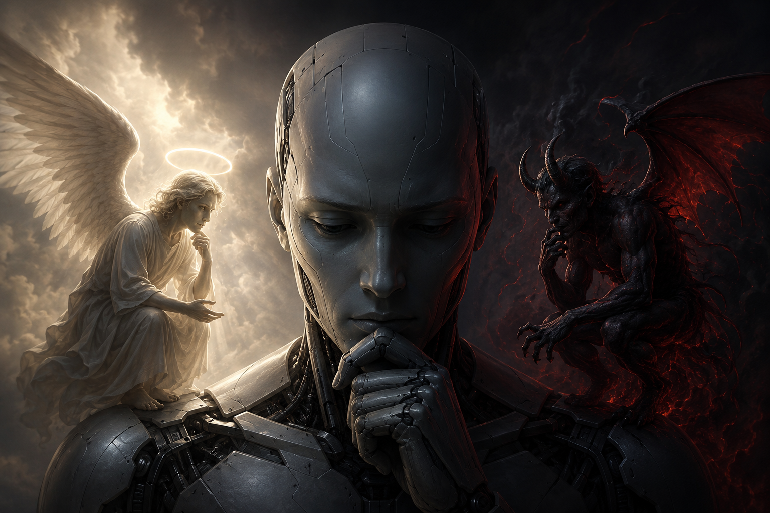
Is AI good or bad?
Notes:
Chatgpt: My prompt for this image. Don't include any words, but give me a cool picture with an angel and a demon like they were on your shoulder that will go with my discussion prompt: is AI good or bad.
That's pretty cool, but what I dislike is that the student looks like a robot. I'd rather the angel and demon look more like robots and the person in the middle look more human
Lots of great discussion from the students

Slide 3
What is a little funny about this AI created image for our discussion.

Slide 4
This picture is an example of how AI can give cool looking stuff, but you normally have to guide it to create what you are really looking for. It’s no different in research.
Original prompt I used: Don't include any words, but give me a cool picture with an angel and a demon like they were on your shoulder that will go with my discussion prompt: is AI good or bad?
Follow-up: That's pretty cool, but what I dislike is that the student looks like a robot. I'd rather the angel and demon look more like robots and the person in the middle look more human.

Slide 5

Is AI good or bad?

Slide 6

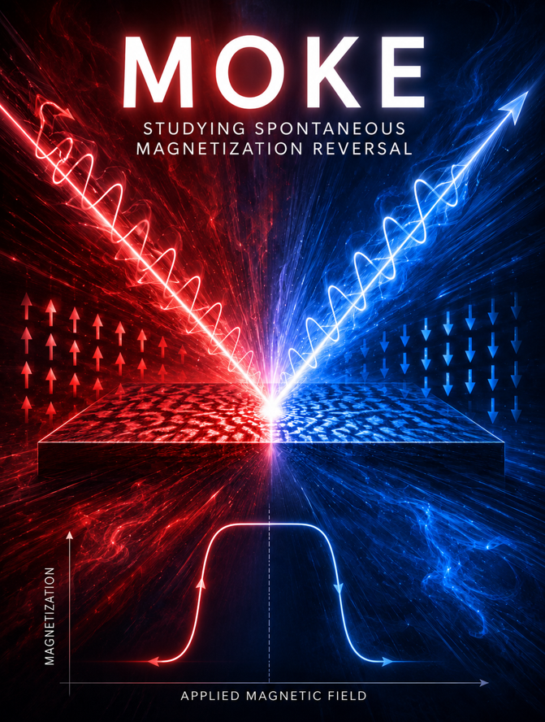
Prompt: My student is making a poster about MOKE studying spontaneous magnetization reversal. We need an eye-catching background. His idea is something with alternating red and blue colors, because that is often associated with magnets
It’s super cool, but what looks weird? (It’s also very busy for a background, but ok.
Change nothing else but can you make the hysteresis loop in the image be more symmetrical.
Notes:
The loop is not symmetrical

Slide 7
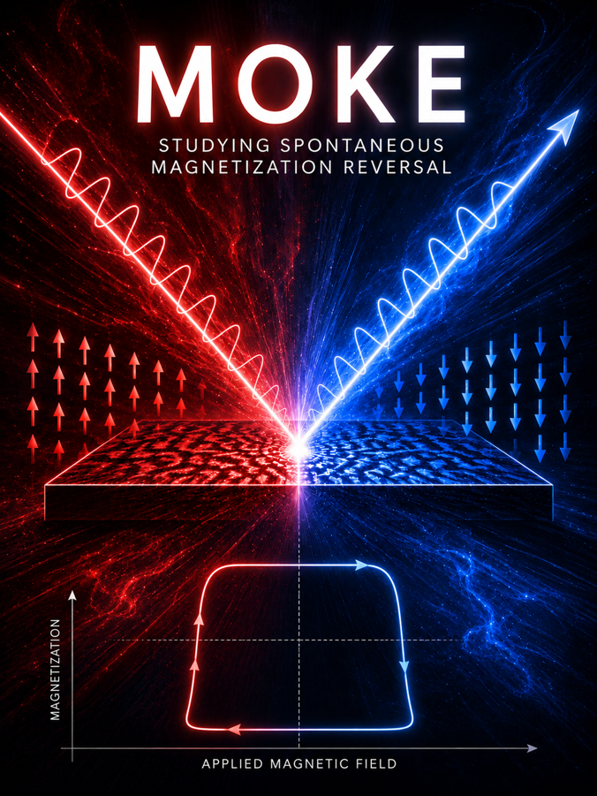
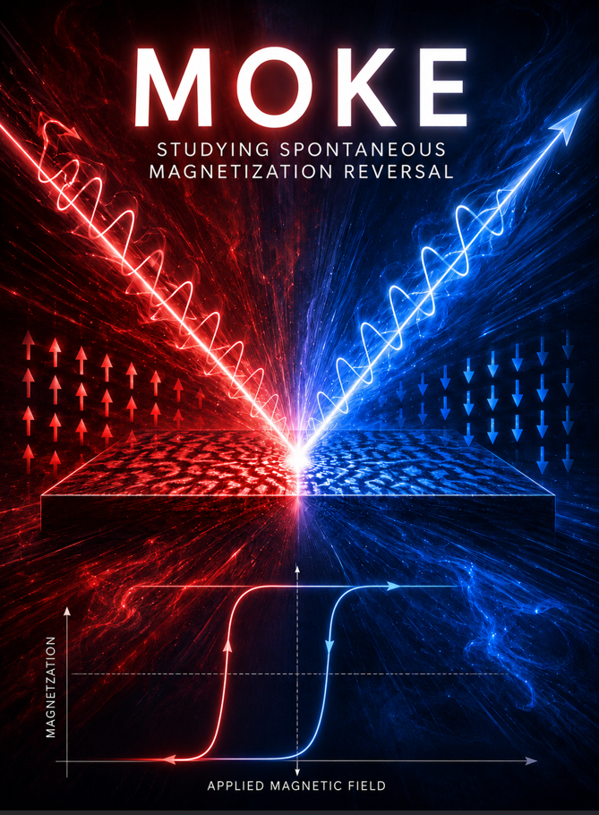
The second one is symmetric, but it is not a hysteresis loop. A hysteresis loop should also be symmetric around zero magnetization.
Much better. I'd like it better if the hysteresis loop were better centered at zero applied magnetic field though. Also, the red incoming light arrow has a weird arrow head at the start

Slide 8
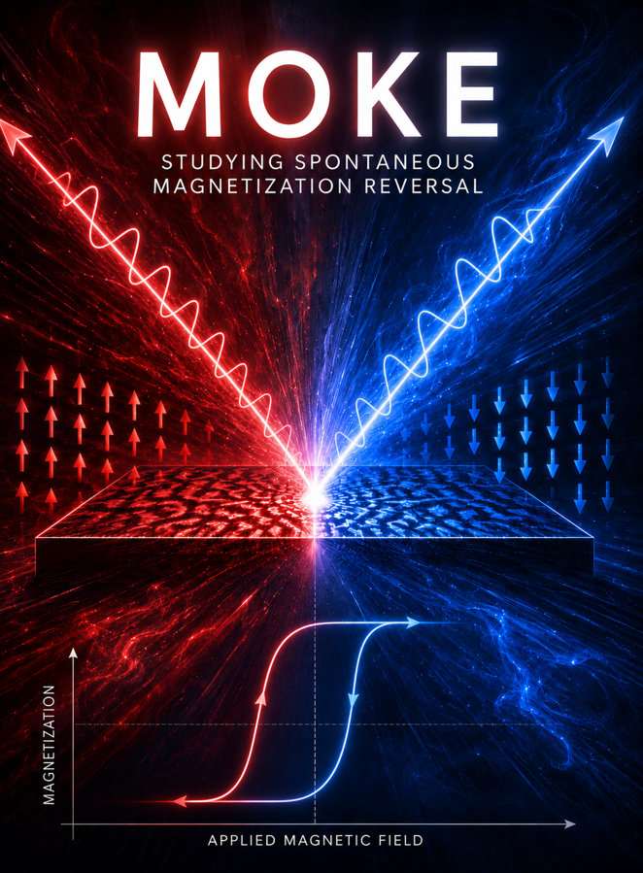
The arrow is better. The hysteresis loop is a lot worse. The prior one was actually pretty good, but I just need the curve shifted to the right a little such that the area in each quadrant is approximately the same
Note that it changed the arrow again. And the loop still isn’t right but better.

Slide 9
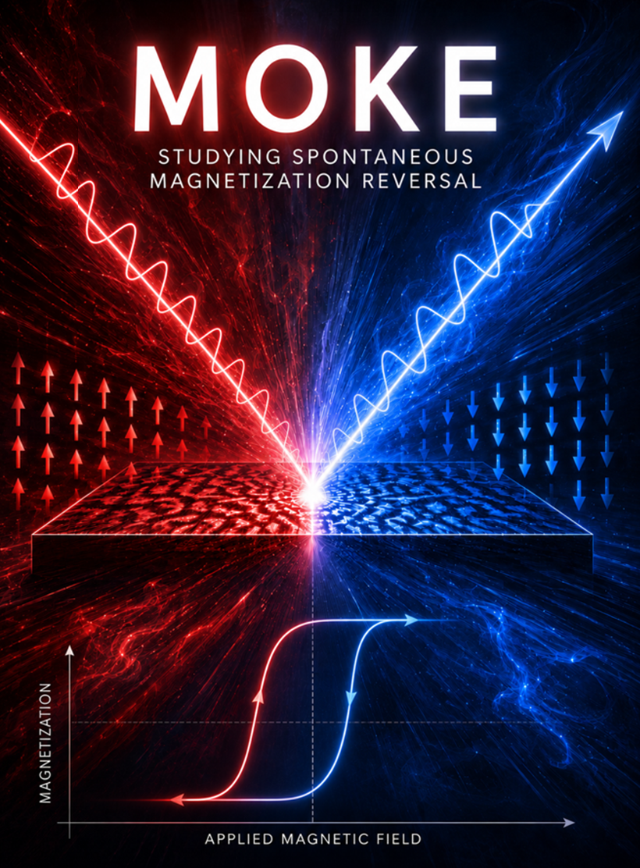
It now fills like chatgpt is just trying to get me to pay for the service. There was no reason for it to mess up the arrow.
Thankfully, I was able to combine two to get close enough to what I want.

Slide 10

I didn’t notice the arrow direction
I suppose I could have asked it to reverse the arrows but I decided it would probably mess up, so I just screenshotted them and rotated them myself

Slide 11
These are examples of guiding AI to give you the pictures you want. Do you have other examples?
My example related to this class
Phrases that help

Slide 12
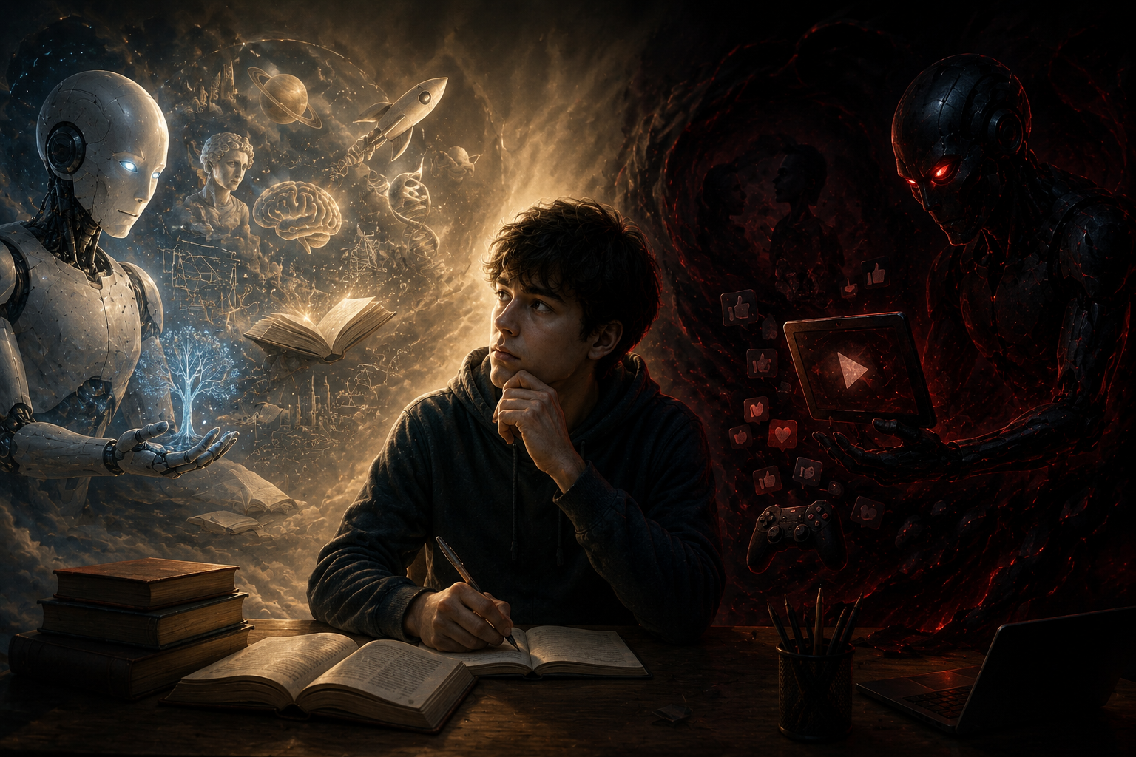
These pictures are examples of how AI can give cool looking stuff….
A similar thing is true for writing.
What is the purpose of learning?
Notes:
My prompt: Ok, what about a background picture for this: These pictures are examples of how AI can give cool looking stuff…. What is the purpose of learning? I'm trying to get the students to think about the fact that the goal isn't for them to just show good stuff, but for them to learn stuff. Sure, AI CAN be used to learn, but it can also be used to avoid learning.

Slide 13
A career in physics requires:
Knowledge
Critical Thinking
Communication Skills
In what ways can AI help or hurt these?

Slide 14
If AI were to go away forever, could you still survive?
Notes:
Maybe a good way to think about why you need to try first.

Slide 15
The Librarian Rushed Through These
I think of AI like an enthusiastic and confident graduate student who still sometimes misunderstands/makes mistakes and needs corrected. I never let me graduate students submit their work without my review!
MYTH | REALITY
AI is replacing researchers. | AI automates tasks, not scholarly communication or judgment.
AI knows everything. | AI tools like ChatGPT predict language and may be confidently wrong. Also prone to bias and hallucination.
Trust no one, particularly AI. Even experienced scientists make mistakes! Currently, not typically as many as AI. Make a good team though.
Notes:
Micky: You said somewhere that generative AI is based on logic. I disagree. I think it’s based on statistics, which means it has some chance of being wrong, and if it tells you X different things, some percentage of them are going to be wrong, but you aren’t going to know which ones—kind of like advice, as we discussed recently in our other class.
I also have a great hallucination story about this class!

Slide 16
While I have mixed feelings about AI, here are my favorite ways to use it.
Theme: Try first
ChatGPT makes really cool looking pictures, but need checked
Brainstorming the best keywords when searching for papers (try first)
Sometimes I’m looking for something very specific in a paper where I know where keywords will not work. Example: Are there any papers you can find that discuss why the ratio of the crystal field effect of spectroscopy should vary for different niobium oxides?
When there isn’t a review paper in my field of interest, AI can be a good start. (try first because a review paper will be much more accurate but maybe not as updated)
While I always practice building my own scientific stories, if I really can’t figure out how to piece it together, AI will give me ideas. Not always good ones though. (try first)
AI is an OK peer reviewer. It won’t catch everything but some.
Improving graphs. Most scientists typically have trouble thinking about how to do more than just show their data in a graph. AI will provide ideas if you say what you are trying to emphasize. (try first)
Troubleshooting problems.
Multidisciplinary research. Every field has its own jargon that make talking between disciplines really hard. AI does this better than the vast majority (not all) scientists.

Slide 17
What is AI not good at?
Apparently giving realistic hiking information
Dealing with anything novel.
Knowing when it is wrong. It will give it to you in a very convincing fashion that makes it quite challenging for many (particularly novices) to recognize errors. It’s easy for even experts to get lazy, or assume it wouldn’t say anything that dumb. (Example: lawyers losing their licenses)
It commonly misunderstands what you mean
Figuring out what questions are important to answer, though it will give you ideas (but they are sometimes generic, boring or not really a big advance)
Knowing what is important, such as differences between similar papers
Knowing when not to trust an assumption or a paper. Hard for novices too.

Slide 18
LLMs are just statistics—predicting the most likely next things to say based off of what it has been trained on. What do you think that means about when you ask it to help you pick a scientific research question?
Is that still helpful to you?
Notes:
Maybe
It means it’s going to give you questions more similar to what other questions it has seen. Can that be useful for a novice? Sure, examples are great! Is it likely to be especially novel? Probably not. Is it likely to be good enough for this class? Yup, that’s fine. Remember, this is practice. You will still learn mostly the same amount in the class EVEN if your research project is a bust. Honestly, LOTS of research projects don’t work out. That’s one of the tricky things for graduate students to get used to. Hopefully, you are learning from those failures to figure out how to do things better.

Slide 19
STEP | AI CAN... | Human responsibility
Brainstorming | Generate Ideas | Ensuring suggestions meet research or assignment needs, have an appropriate scope, does not merely recylce existing research or ideas
Information Searching | Suggest Search Strategies | Ensuring the suggestions are relevant, are appropriately broad or narrow depending on needs, suggest strategies that are possible with where you are searching
Reading & Synthesizing Sources | Summarize Sources | Ensuring the AI output Is accurate, free of bias or hallucinations, and logically links sources
Writing | Draft, Organize | Ensuring appropriate scope, formatting, Information, and citation. Consider if output may contain copyrighted material or IP not appropriate for your own use
Editing | Structure or Grammar Suggestions | Ensuring suggestions are accurate, follow writing conventions, and are logical
Publishing & Research Impact | Journal Recommendations | Ensuring the suggested publications actually exist and, if so, are relevant to your field or the subject your are researching
Notes:
The remaining slides were made by Jeff Werst, the librarian. I think I made a few minor edits.

Slide 20
Early in the process | In the research stage | Further in the process
Generating ideas | Finding sources – using tools that summarize | Critical Thinking – ask a good question
Narrowing the scope of a topic | Finding connections – tools that harness data | Feedback – Avoid ChatGPT for this (or really any large LLM)
 | Formatting References – Citation Managers | When you are stuck on transitions, headers, titles
 | Outlines – to organize thoughts and research | Cite your AI use
Notes:
Micky: Catch typos too

Slide 21
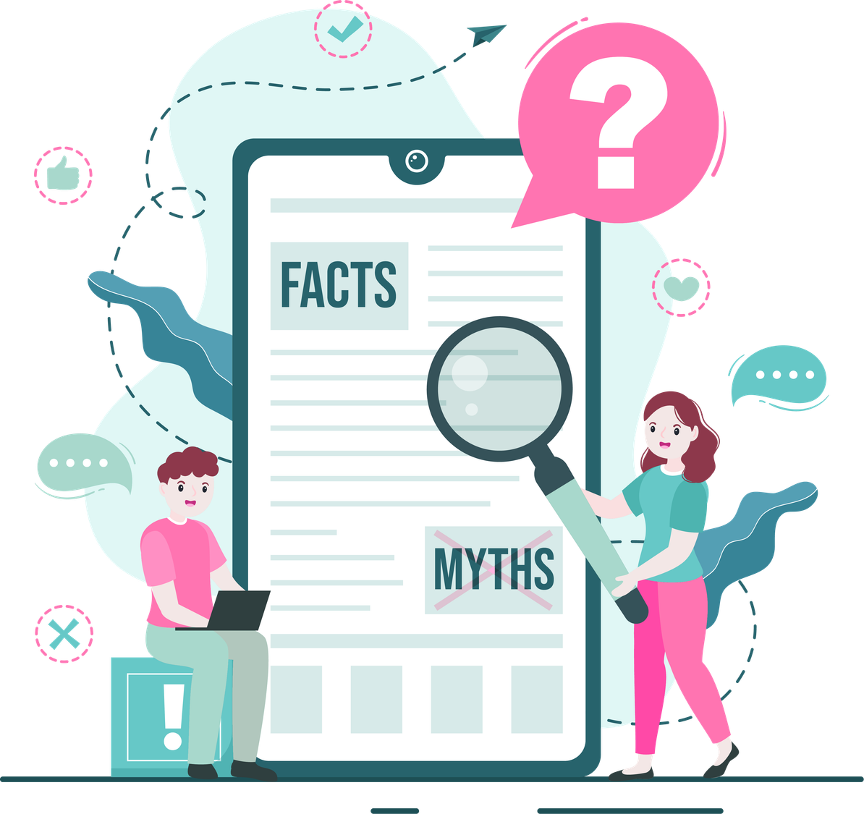
How can I use AI responsibly?
  Weigh the pros and cons to determine if AI is the best choice for a task.
  Determine if output is missing context or displays evidence of bias.
  Fact-check output and apply human judgment
  If sources are given or cited, do these exist? Do they even appear related? It can be wrong!
  Are you considering the privacy implications and your own intellectual property? Don’t put in anything you don’t want used to train. Don’t put in personal info.
Notes:
Generative AI is likely the type of AI you are most familiar with or most associate with AI in the classroom at least. Generative AI refers to systems that create (or generate) something – be it an image, a video, or even text like an essay – based on a prompt given to it by a user. Generative AI tools have exploded into the public eye recently as they’ve become more accessible, with many being offered free for users.
Micky: I removed this question, not because I don’t agree but because I think that would be challenging for these students to know: Is anything included or drawn from that may be copyrighted or put someone else’s IP at risk?

Slide 22
AI Warnings and Considerations
If you use AI, use it as a tool, DO NOT use it to replace yourself in creative or critical thinking, let it assist, not do all the work
AI usage should be disclosed and cited
AI results can be biased, their algorithms are often unclear to us
Not all tools are created equal, and paywalls exist in tools as well
AI tools can’t bypass paywalls, ie: they can’t get articles in databases
Be aware of any assignment, university, funder, copyright, or ethical considerations regarding AI
AI will take whatever you give it to use in its own learning; it can and will steal your ideas and inputs, which is a major privacy and copyright concern
AI “art” steals ideas from artists and creatives
AI tools use a lot of energy and resources, there are major environmental concerns
Notes:
For any searching you do, there’s some basic tips you can use. First and foremost, is what we did first, isolate the main concepts you are interested in or need to cover. So that is making your research question, and picking out specific terms or ideas. Next up, you want to think of synonyms or related terms for the words and ideas you isolated first. You will be using all of these in your search, if only to make sure you aren’t missing out on potential results. Finally, you can use one good source to find another. Think of it like recommendations on Amazon or Netflix, their creepy algorithm can tell you what others have bought or watched that’s related, and searching can do the same thing.

