Slide 1
Experimental Schedule
Sample | Availability
LSMO | Ready
FeS/FeTe (altermagnets?) | Completed/Ready
Fe thin film | Ready
Topological insulator | Shipping label sent, waiting on Oak Ridge
Groups (experiments will run for ~24-72 hours, but you don’t have to be on call, will text if need anything from you)
Oct. 5, Monday 4pm: Ryan, Gavin, Alp Completed
Oct. 27, Tues. 10:15am: Evan, Jeffrey, Austin (part broke)
Oct. 16, Friday 5pm: Melissa, Shelby, Leeam Completed
Oct. 20, Tuesday 4pm: Bryce and Tyler In Progress
Oct. 23, Friday 1:30pm: Nickolai and Durham Friday

Slide 2
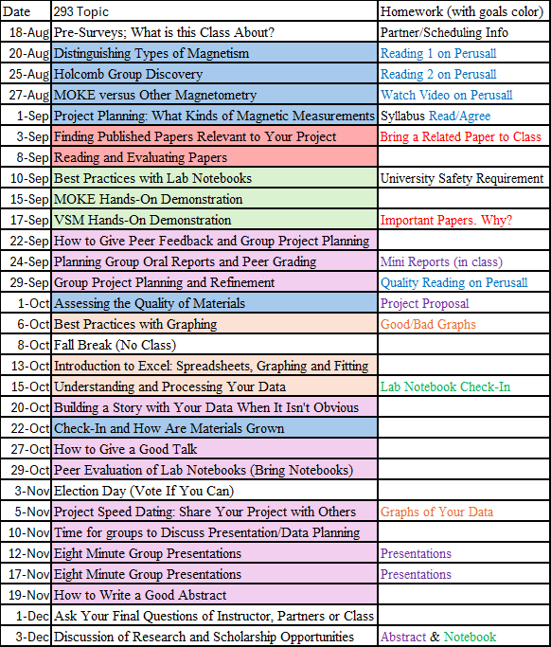
Today:
Last day before penalties on all eligible past assignments except lab notebooks
Good/Bad Graphs
Bring in examples of good and bad graphs from a paper. I don’t need the whole paper. Discuss why you think they are good or bad.
DO NOT just google looking for good and bad graphs. I want YOU to practice recognizing what makes a graph good or bad-- not someone else. It’s ok if we disagree on what is good or bad.
50% after Oct 22
50% after Oct 13
(2-5)
50% after Oct 13
50% after Oct 22
Story First
Any last minute requests?
Can submit early for feedback
5% Bonus
FeS/LSMO
Rest
10-15 Min Group Presentations
No Bonus
5% on time bonus
Notes:
Related paper= related to your project. I don’t require it but it will help you better figure out what
Can also point out the blue theme means we are stepping back to talk about related characterization methods that could be useful someday.
I’d like to get to the secondary peaks, but I could live with only getting to the one before that. May need to finish off a little of this before the next lecture.

Slide 3
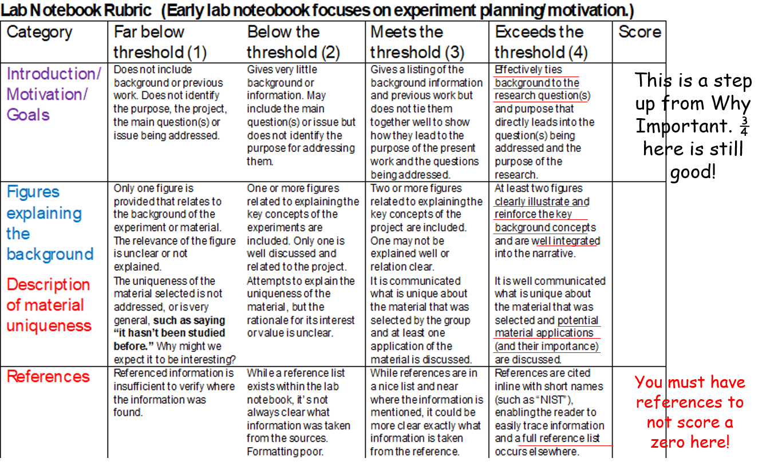
If you want to be able to have a chance to resubmit, notebooks must be turned in by Tuesday, Oct 27. Last revisions are due Oct 29. You can do before and maybe you can have a second round if needed. Average of first attempt ~7/10 (B-)

Slide 4
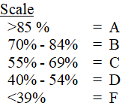
How Your Grade is Calculated in eCampus
It calculates what it has scores from you already.
For the lab notebook, I have not yet entered zeros for missing ones, so it’s calculating what you have before that if you haven’t gotten a score yet. For those of you that have turned it in, it calculates given that score.
All assignments on ecampus say twice the actual percentage points.
191 has the more normal 90-100 scale
Notes:
Add this earlier in the course slides too

Slide 5
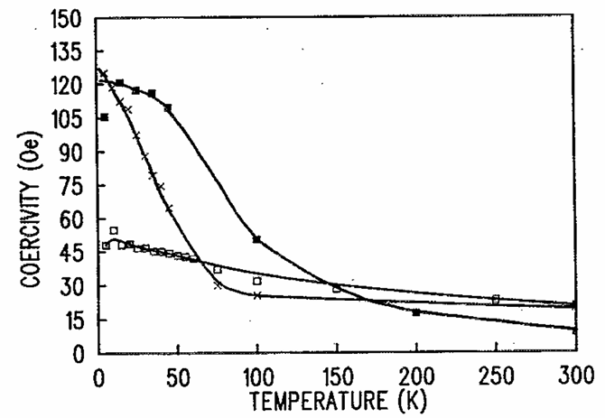
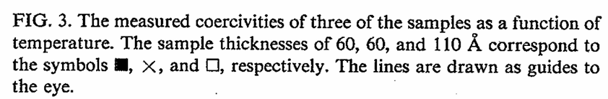
Non-ideal graph example
What is this?
This is a good example where a guide to the eye is helpful.
Paper written in 1991
Also too many y numbers; I’d do steps of 20

Slide 6
Ways to Improve: Add Label/Legend and Color
x 6 nm
7 nm
11 nm
6 nm
7 nm
11 nm
If these were in color, which would you like best?
Add color to the lines and points
Actually the “7nm” is also 6nm, but I wanted to make it clear how you could label three different. With two of the same thickness, I’d probably make them two different shade of the same color and have one 6 nm label
Personally, I like the labelled version (right) better. Can lose effectiveness if you had more samples
Notes:
https://doi.org/10.1063/1.348347, actually the two smallest are 6nm
You will see many graphs with legends like on the left in papers. It’s better than the graph that buried the legend in the caption, but I like the right one better.

Slide 7
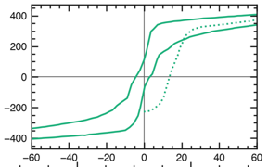
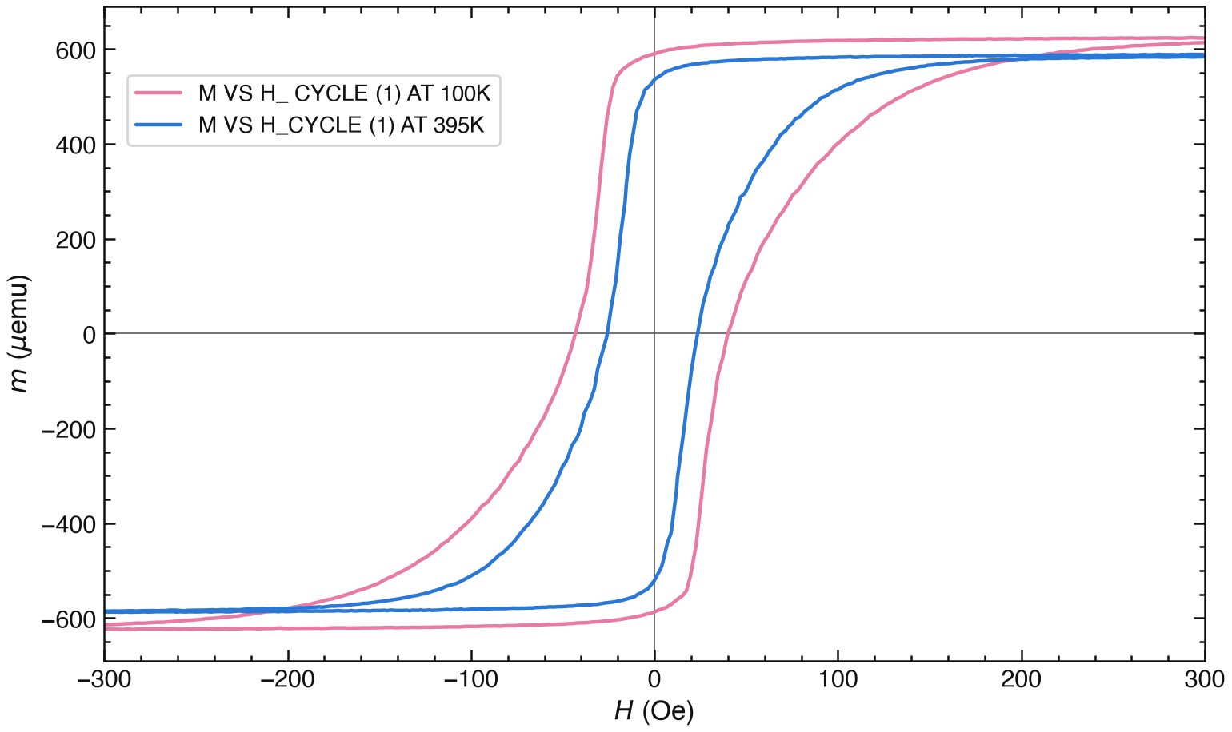
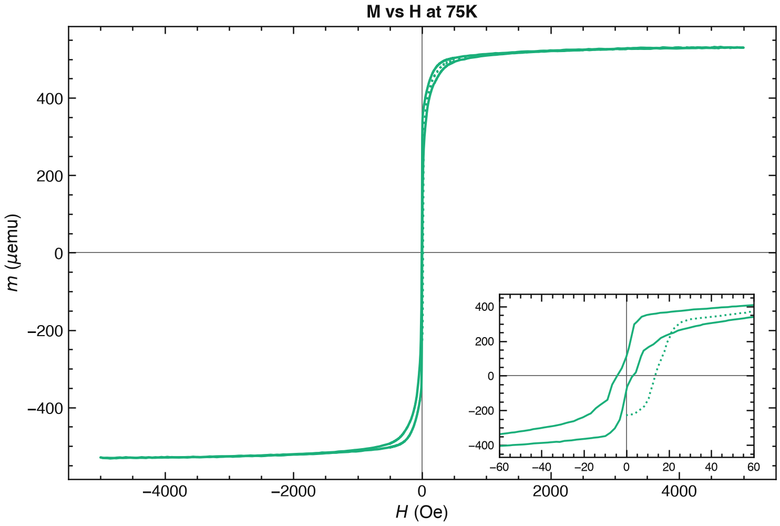
What kind of magnetism dominates?
Mr
Fe
LSMO
Zoom out would look similar except that Fe Mr is higher
What looks different to you?
Are either of these what you expected?
Zoom out of LSMO

Slide 8
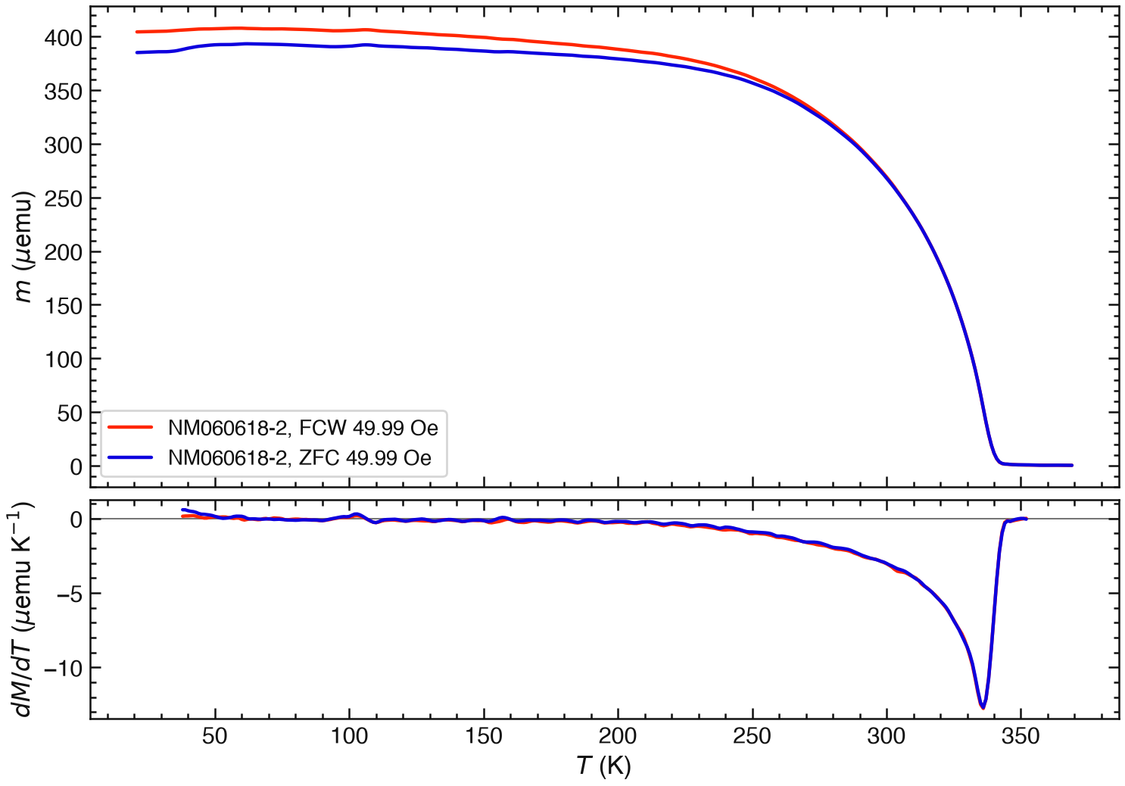
LSMO: NM060618-2 sample (37.7nm)
50 Oe
Why did Femi plot this?

Slide 9
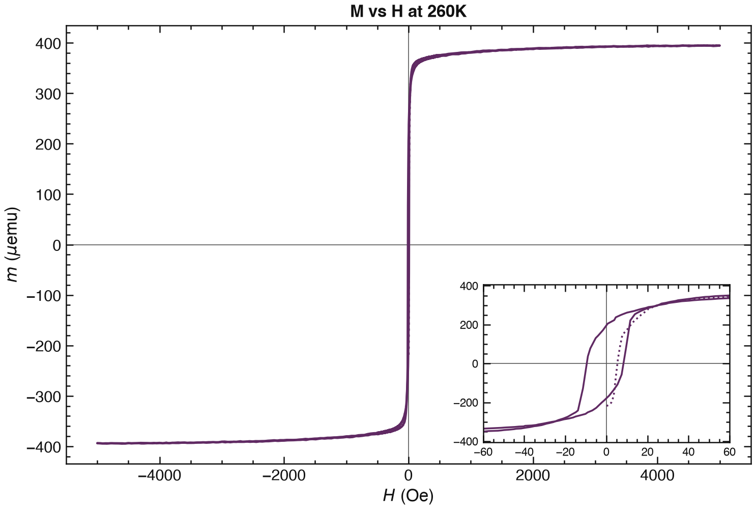
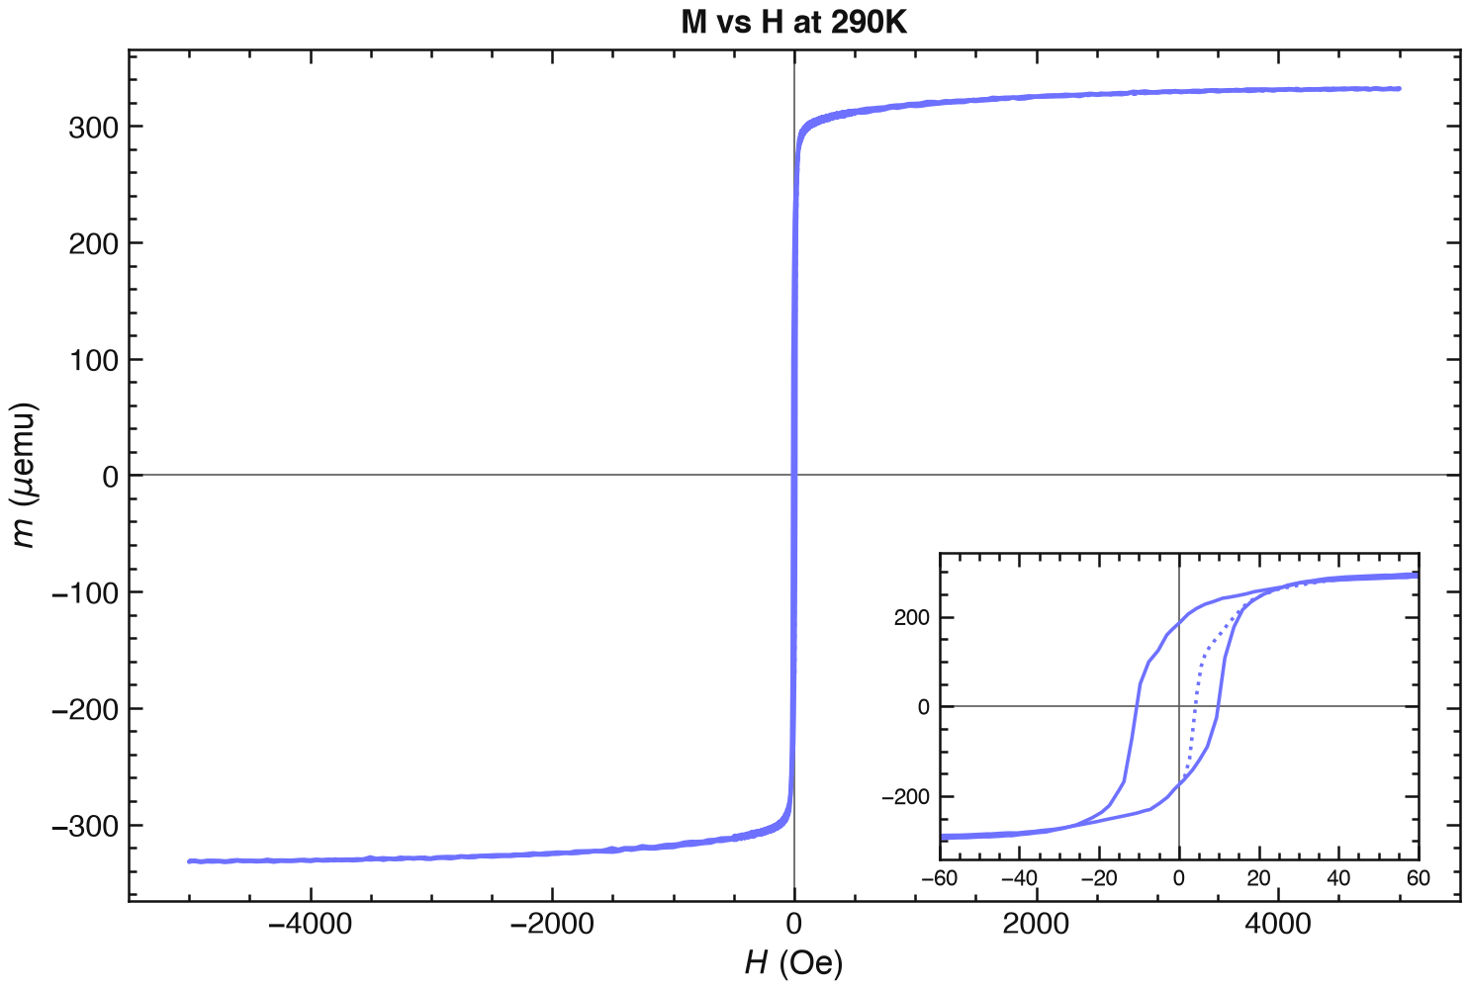
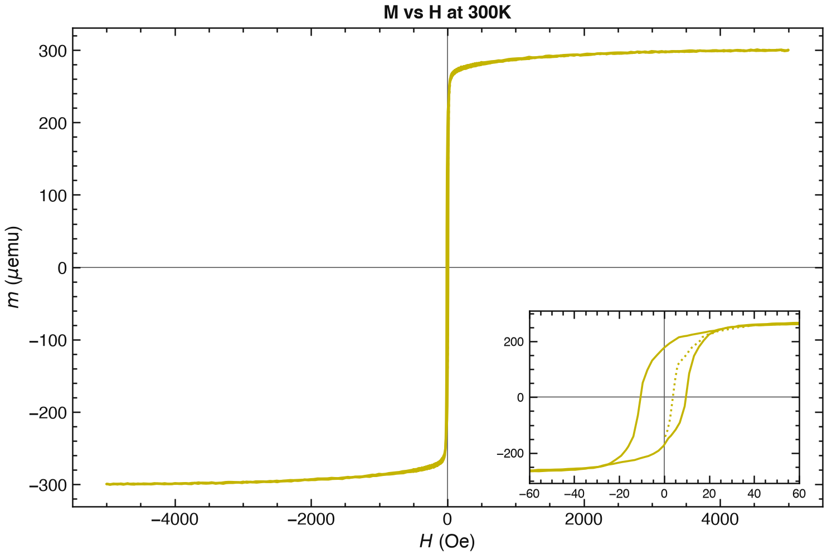
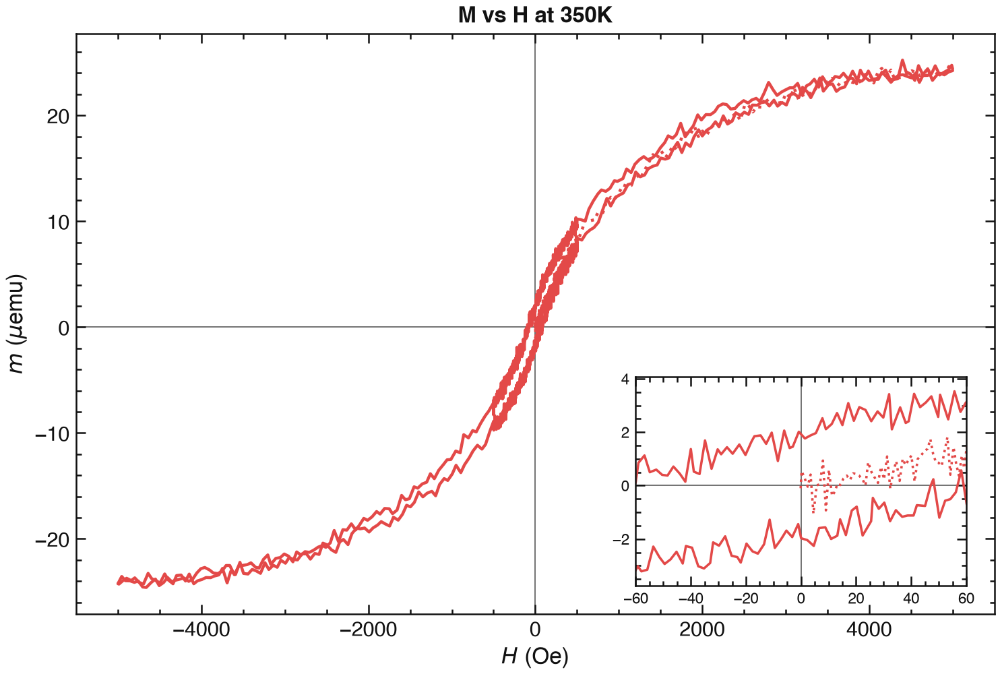
LSMO: NM060618-2 sample (37.7nm)
50 Oe
If you are going to show both, switch the zoom in and the zoom out
Does the Mr change with temperature beyond T>350K?

Slide 10
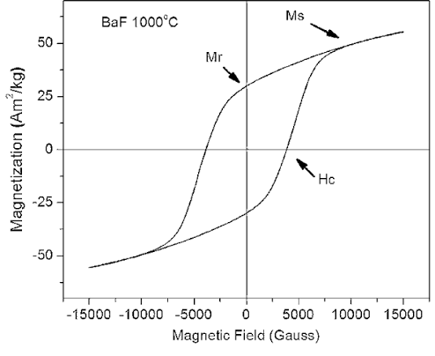
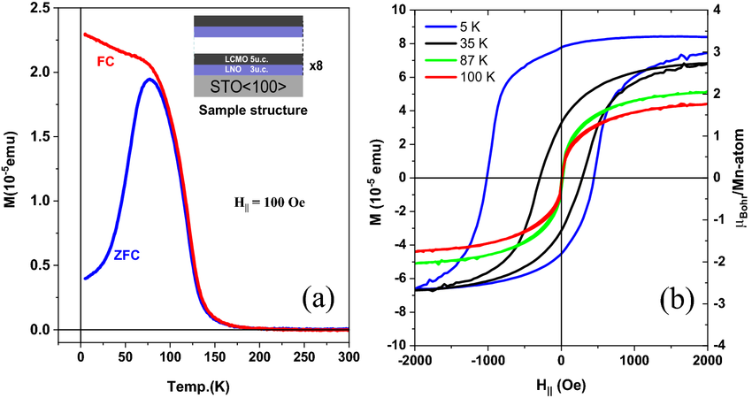
Last time: Things you might compare
Ms, Mr, Hc, one other thing here
This would be an example where taking more loops would help
When centered
Notes:
It also has significant exchange bias, meaning the loop isn’t centered about zero

Slide 11
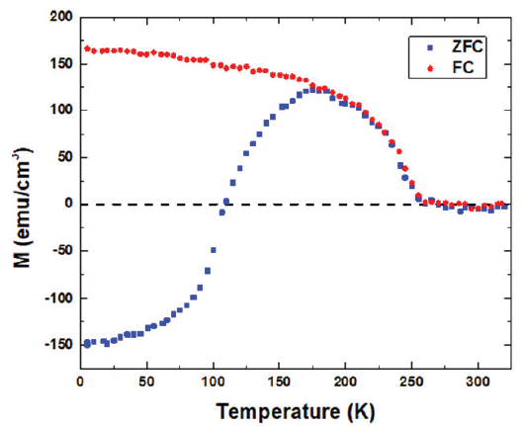
Example 2: While magnetization data is generally useful, if we want to study spontaneous magnetization reversal, we expect two things
A sign difference in the magnetization direction between the magnetization when cooling in a field and not
(On its own, experts will be skeptical)

Slide 12
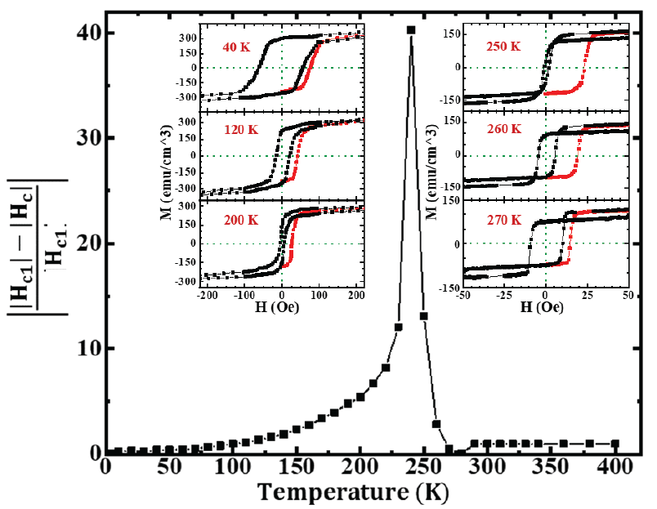
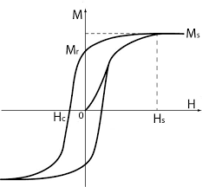
2. Inverted loops and/or weird red region
Normal loop
Also, a non-zero starting curve even at low temperatures

Slide 13
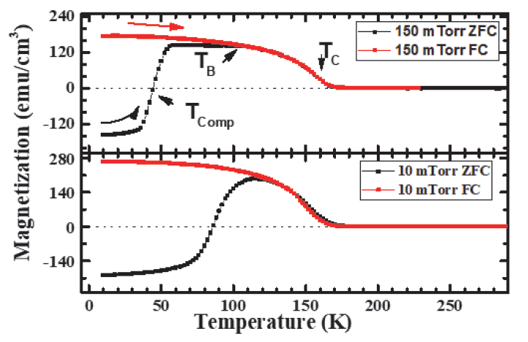
Things you should do with your data
1. Find the Tc – Remember How?

Slide 14
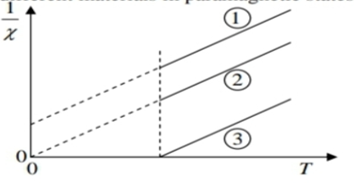
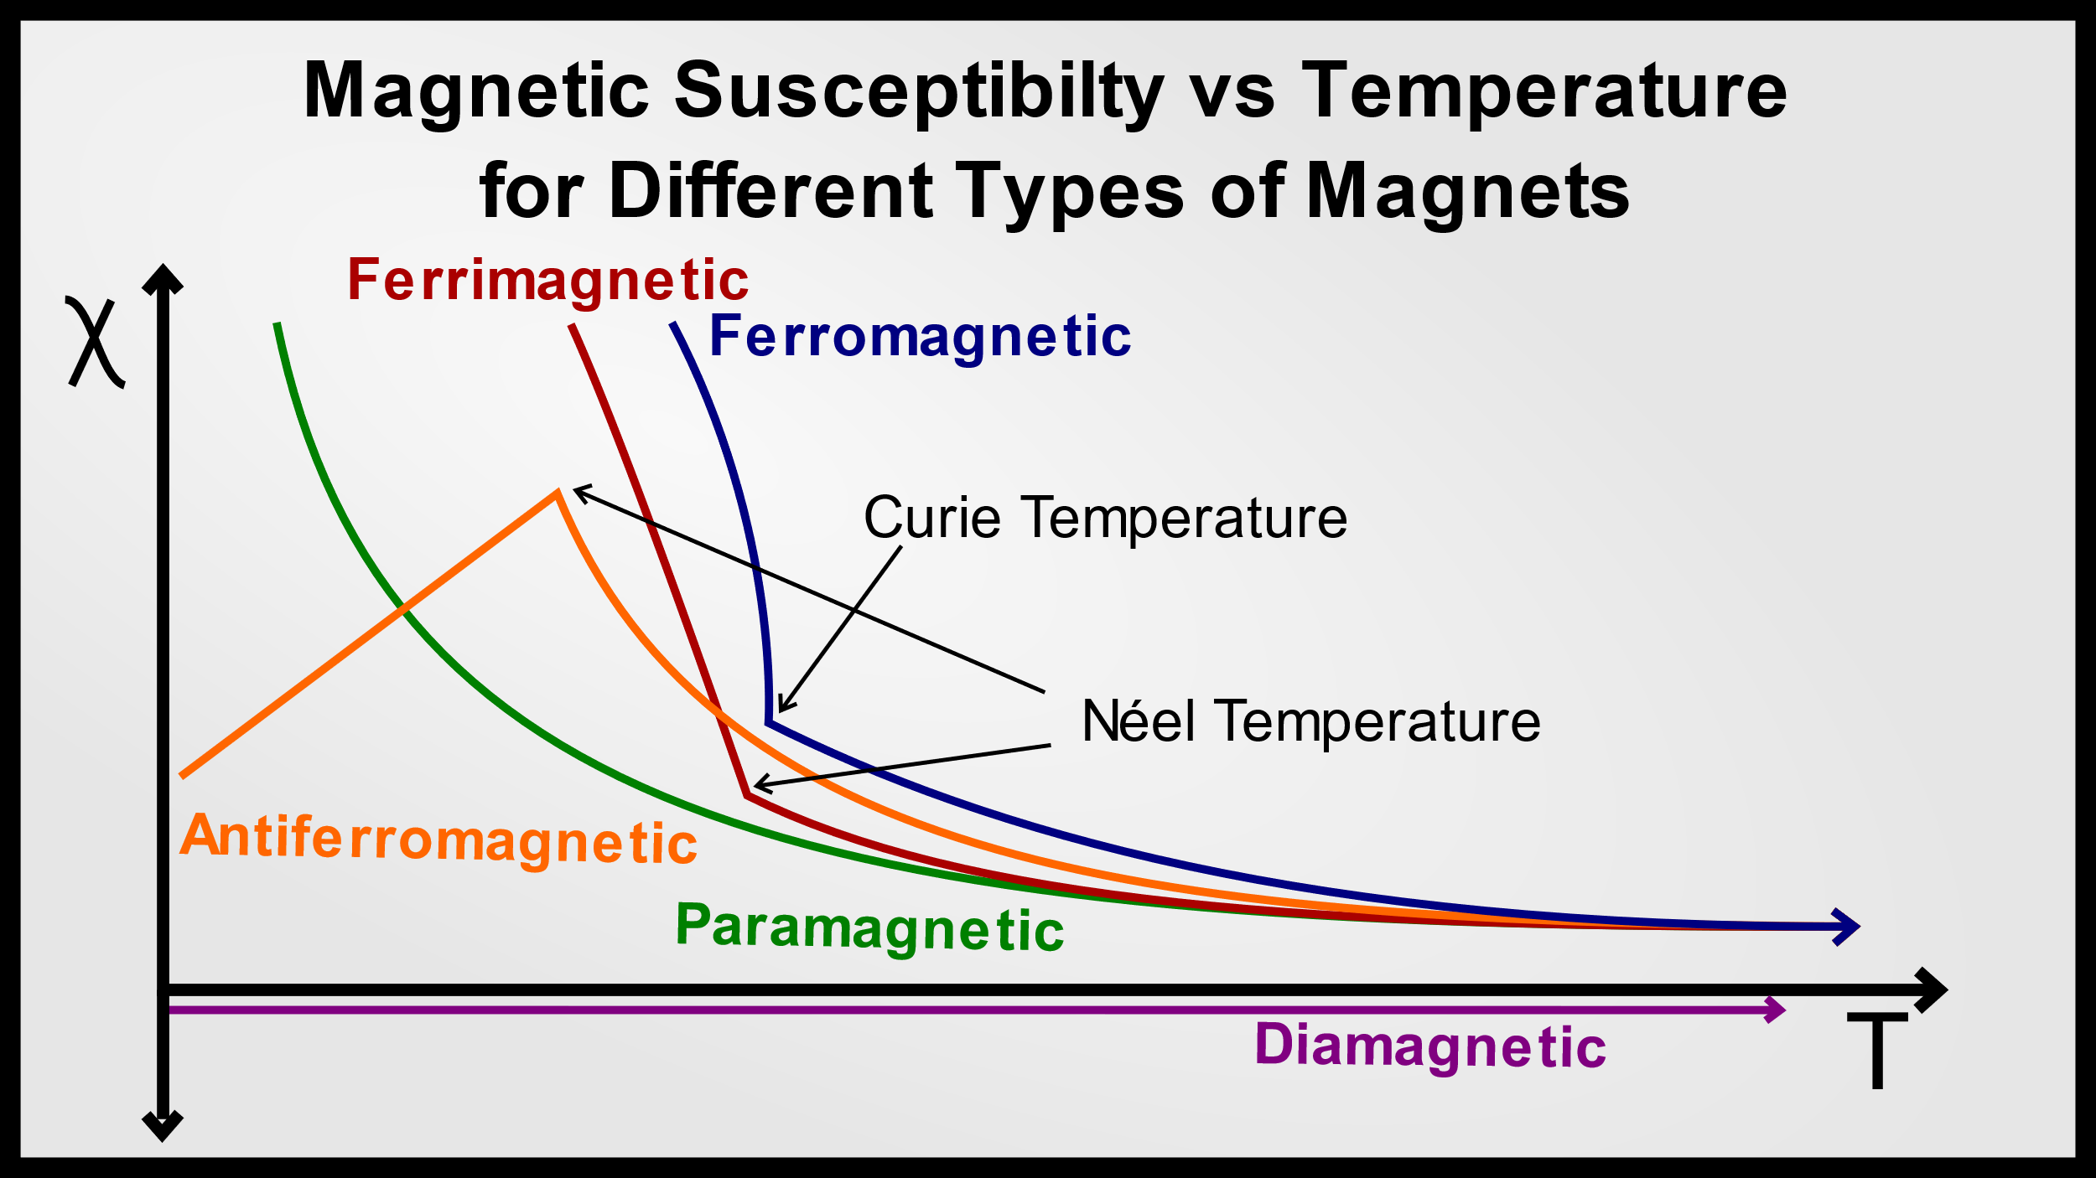
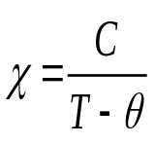
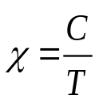
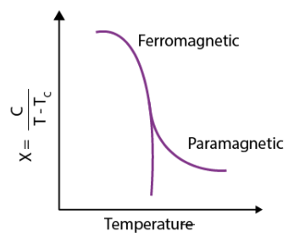
We try a few ways
-Try to fit it -Look at derivatives
- Plot 1/χ
-If time, measure M vs H at many temps (best, costly)
(M = χ_{m} H)
Curie-Weiss Law:
ferromagnetic Curie temperature θ
Curie Law
Independent of temperature (depends on H field)

Slide 15
You Might Be Able to See Variations by Comparing and Contrasting Your Films to Similar Ones
What should you compare with?
It could be a similar sample (ex. FeS/FeSe/FeTe)
A different thickness
Or other stuff you find in the literature
To publish something, you need to create a story that you can back up around your findings.

Slide 16
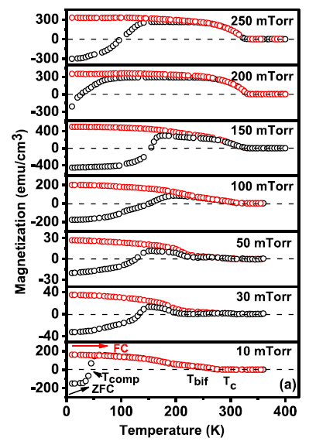
Do NOT limit your comparison to only the critical temperature!
What are other things that change?
LSMO
LMO

Slide 17
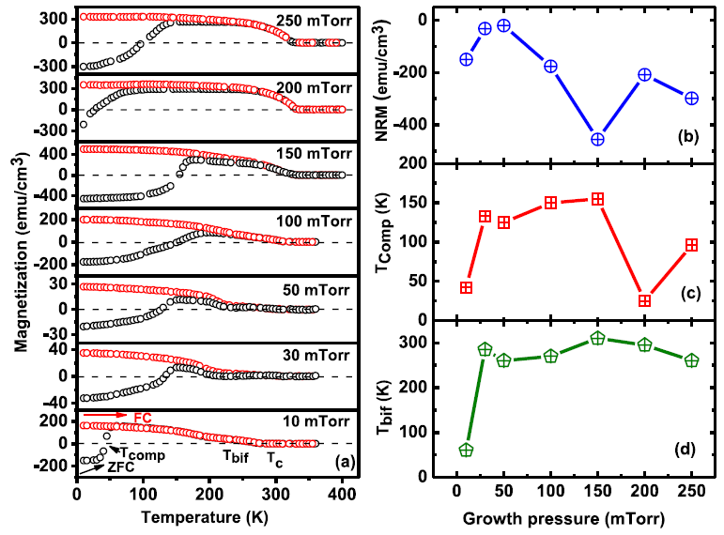
When you have enough films, it is wise to try everything you can think of and see if you see a trend. If you don’t have many samples, what else could you try?

Slide 18
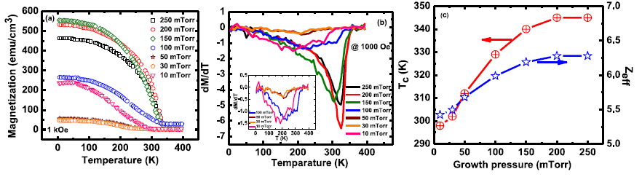
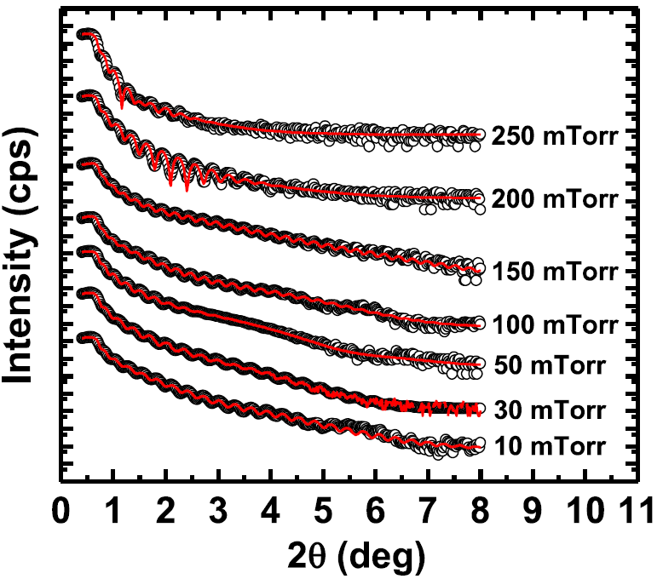
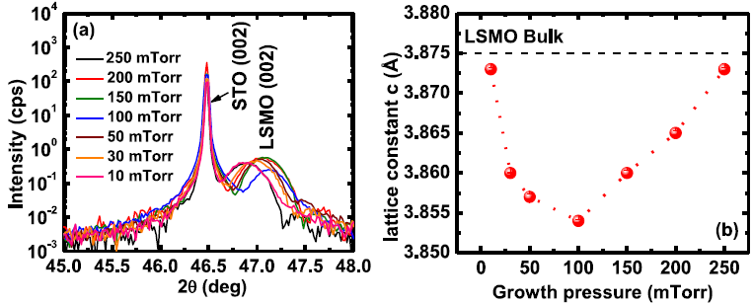
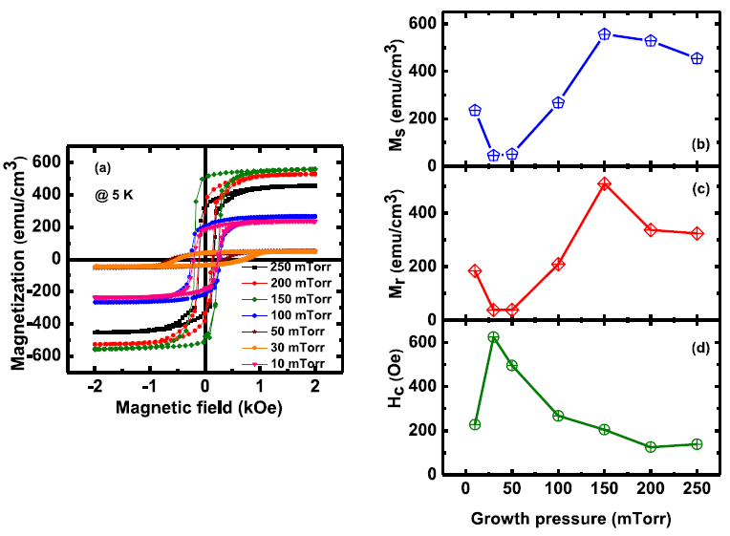
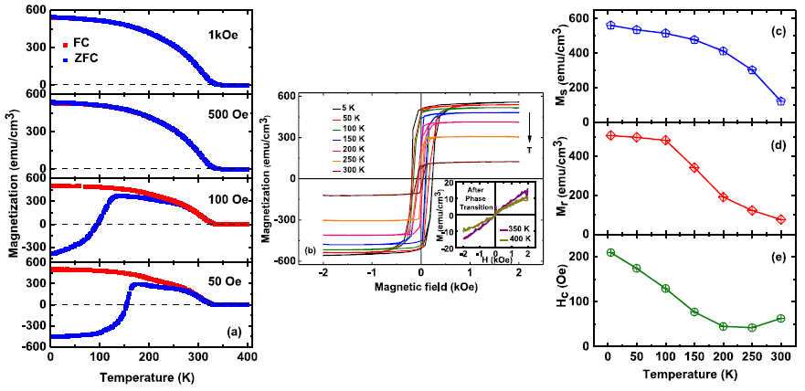
No, really. EVERYTHING!!! How do you pick what to use?
XRR
XRD
Analysis from XRD
Notes:
Try different things until you find a story that makes sense that you can confirm

Slide 19
How Do You Make A Story?
It’s tricky, and you get better at it with practice but having many comparisons help
And sometimes it’s still not obvious.
Let me show you what I do with that mess of data when I present it to an expert audience.

Slide 20


Why Negative?
Navid Mottaghi, et. al. JPCM 2018
Applied Field
Can we control this phase?
The red arrows are ferromagnetic moments which are normally aligned in the direction of the field.
We have a diamagnetic-like phase that aligns counter to the applied field.
As long as the applied field is small enough, the field from the diamagnetic-like phase dominates the applied field. Leads to a rapid switch when limit is overcome.
Notes:
My normal story about how we have a competition between ferromagnetism and something behaving kinda like a diamaget.
Then, how can we control this?

Slide 21
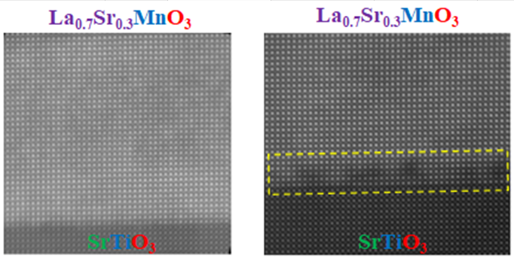
Oxygen Pressure Variation
Wanted to see effect of oxygen vacancies so adjusted oxygen growth pressure
XRR
50 mTorr
10 mTorr
Kumari , et. al. Scientific Reports 2020
While our films are optimized at 100-150 mTorr oxygen growth pressures, we could still get high quality films down to 3 mTorr.
Notes:
We guessed that we might be able to control it with oxygen vacancies (missing oxygen). Note that even in non-optimal oxygen growth pressures, our films are still pretty good, as shown here by both TEM and nice XRR fringes.

Slide 22
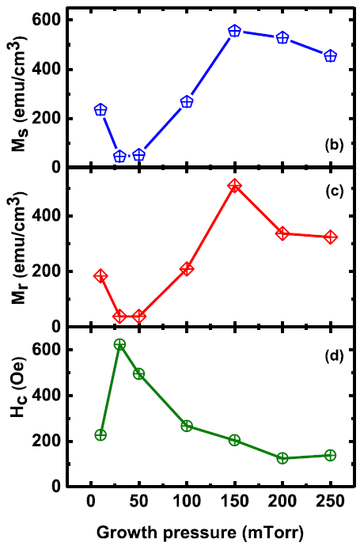
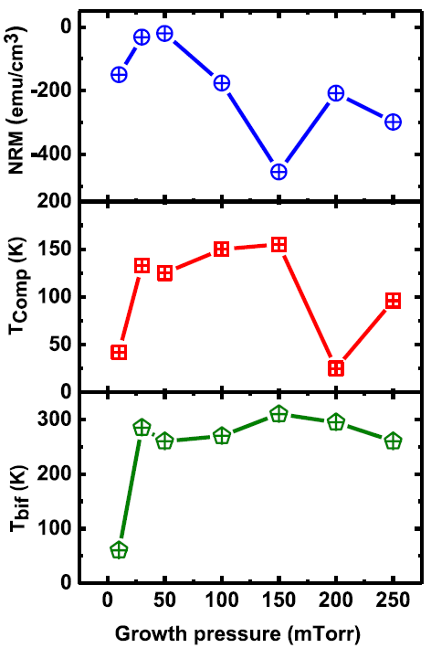
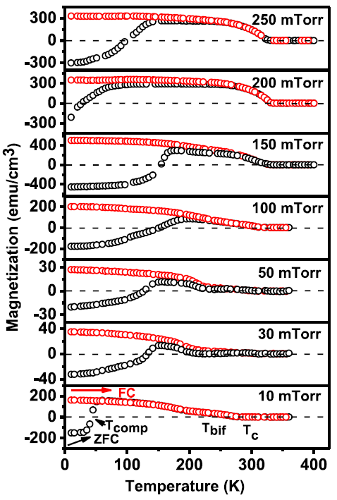
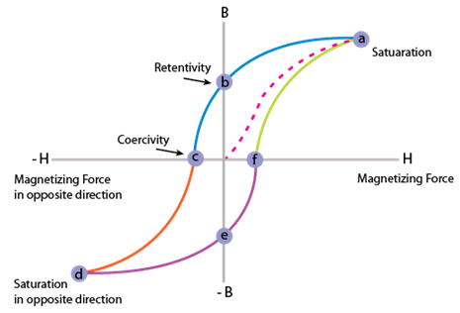
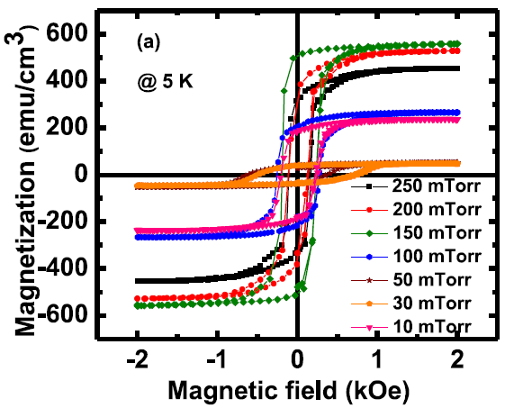
Oxygen Pressure Variation
FC (50 Oe)
ZFC
Spontaneous magnetization reversal happens regardless of oxygen growth pressure, but varies a little
Region 1: Maximize the M_{S} and SMR
Region 2: Minimize the SMR
Can increase with smaller field
M_{S}
M_{r}
Kumari , et. al. Scientific Reports 2020
H_{c}
Notes:
So, no obvious trends here, however, we can look at two regimes. One where this spontaneous magnetization is maximized, and one where reversed.

Slide 23
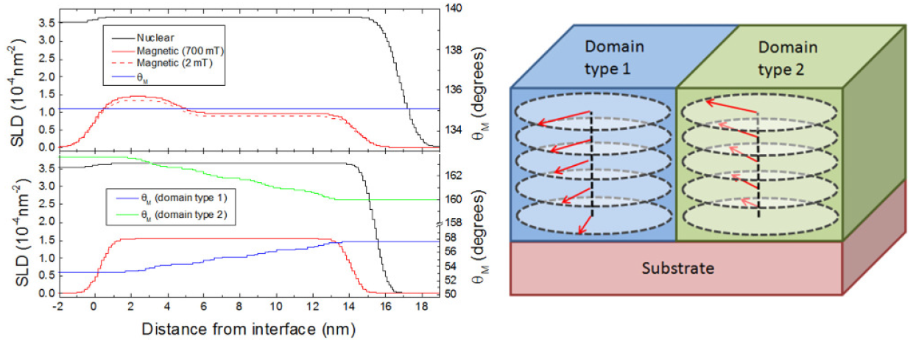
✪
Magnetic Profile Changes
Polarized Neutron Reflectometry
Oxygen Deficient
Region 1:
100 mTorr
Region 2: 10 mTorr
H
Rob Trappen, et. al. JAP 2019
Notes:
You don’t need to understand the complicated curves on the bottom to see that the magnetization depth profiles do very different things in these two regimes.
15.8 nm
Spin flip reflectivities

Slide 24
Unfinished vs Finished Stories
Completed Research
Why should I care?
What did you do?
What did you find?
Why are these findings important?
Do any of these questions look familiar?
Incomplete Research
Why should I care?
What did you do or plan to do?
What do you expect to find?
What have you found so far if anything?
What are the next steps?
Why are these steps important?
Notes:
Yes, we’ve been working on story building most of the semester, with multiple opportunities for feedback! While you may not have started having any idea what you were doing (which is normal when first beginning research), you have at least a little better at this over the semester!

Slide 25
I ran out of time to talk about growth, but here are the slides

Slide 26
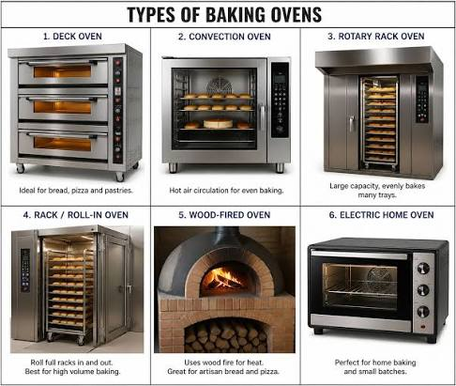
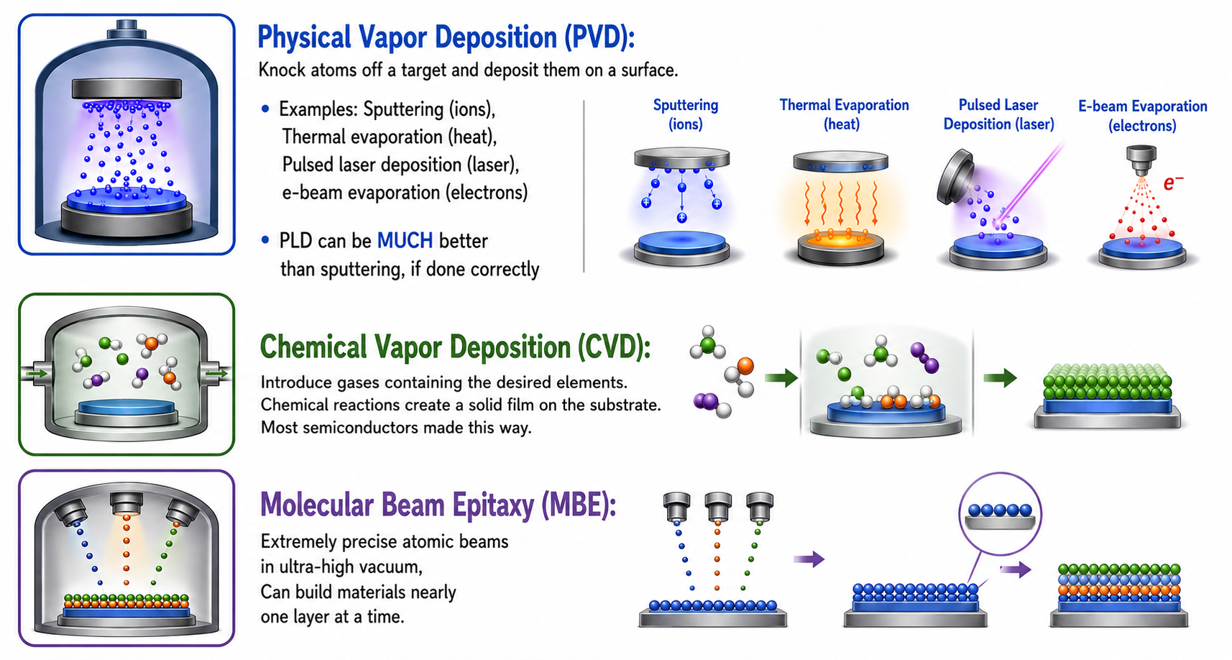
Common Thin Film Deposition Techniques
Goal | Good Method
Large crystal | Melt growth
Cheap synthesis | Solution growth
Magnetic thin films | Sputtering / PLD / MBE
Atomic-level control | MBE
Large-scale manufacturing | CVD
If we don’t decide we have more important topics to discuss later, I’ll go into these more Oct 22.
Oxide best*
Normally best but maybe not for oxides
*if have a special tool
Notes:
Physical Vapor Deposition (PVD): Knock atoms off a target and deposit them on a surface.
Examples: Sputtering (ions), Thermal evaporation (heat), Pulsed laser deposition (laser),
Electron-beam evaporation: A focused electron beam melts/evaporates the source material.
PLD can be MUCH better than sputtering, if done correctly
Chemical Vapor Deposition (CVD): Introduce gases containing the desired elements. Chemical reactions create a solid film on the substrate. Most semiconductors made this way.
Molecular Beam Epitaxy (MBE): Extremely precise atomic beams in ultra-high vacuum, Can build materials nearly one layer at a time.

Slide 27
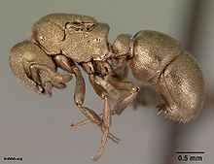
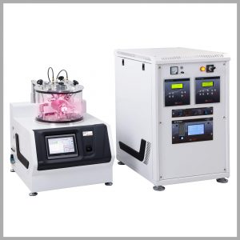
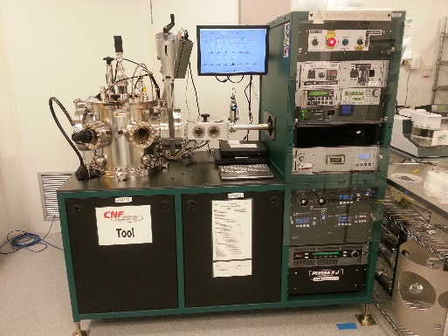
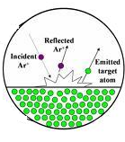
Sputtering
Sputtering is a term used to describe the mechanism in which atoms are ejected from the surface of a material when that surface is struck by sufficiently energetic particles
Discovered in 1852
Most utilized for metals
Very easy and quick
Great for uneven surfaces
Often for electron microscopy
Lower crystalline quality
Notes:
Electron microscopy doesn’t work well for charged surfaces

Slide 28
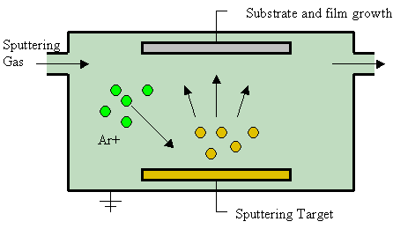
Sputtering
There are different ways to give the collision material energy. High voltage shown here (common approach).
Not always argon.
The atomic weight of the gas should be close to the atomic weight of the target.
Light elements: neon
Heavy elements: krypton or xenon.
Reactive gases can also be used.
vacuum
Substrate is typically on top. Any ideas why?
Notes:
Sputtered atoms ejected from the target have a wide energy distribution, typically up to tens of eV (100,000 K). The entire range from high-energy ballistic impact to low-energy thermalized motion is accessible by changing the background gas pressure.
For efficient momentum transfer, the atomic weight of the sputtering gas should be close to the atomic weight of the target, so for sputtering light elements neon is preferable, while for heavy elements krypton or xenon are used. Reactive gases can also be used to sputter compounds.

Slide 29
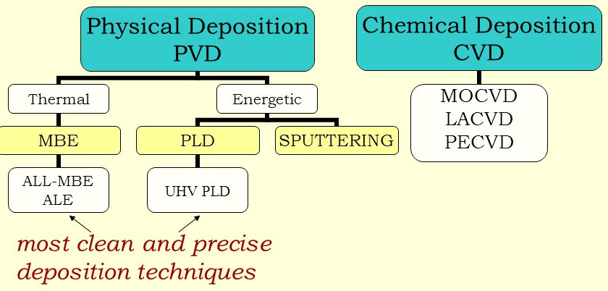
Just a bunch of fancy names
MO = metalorganic
LA = laser assisted
PE = plasma enhanced
ALD
PLD = pulsed laser deposition
MBE = molecular beam epitaxy
CVD = chemical vapor deposition
ALD = atomic layer deposition
Most common growth techniques in condensed matter physics

Slide 30
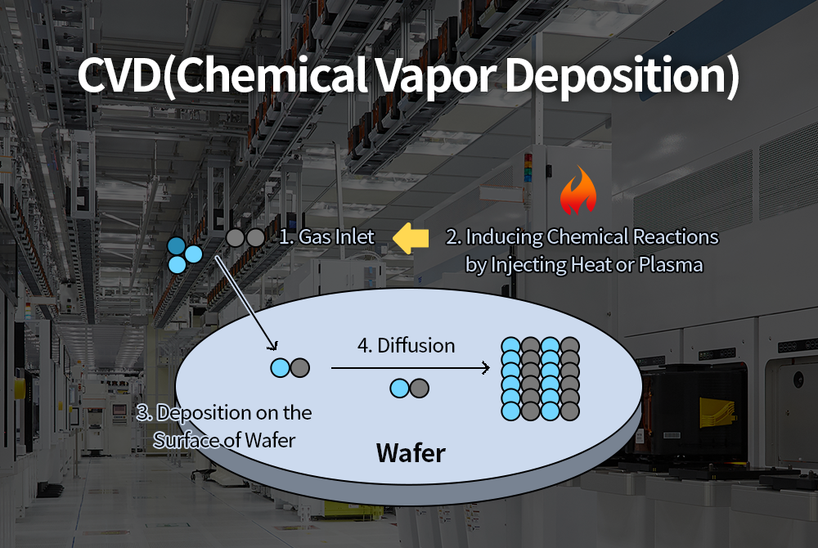
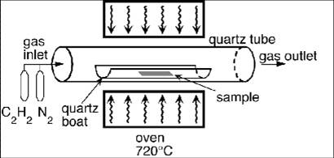
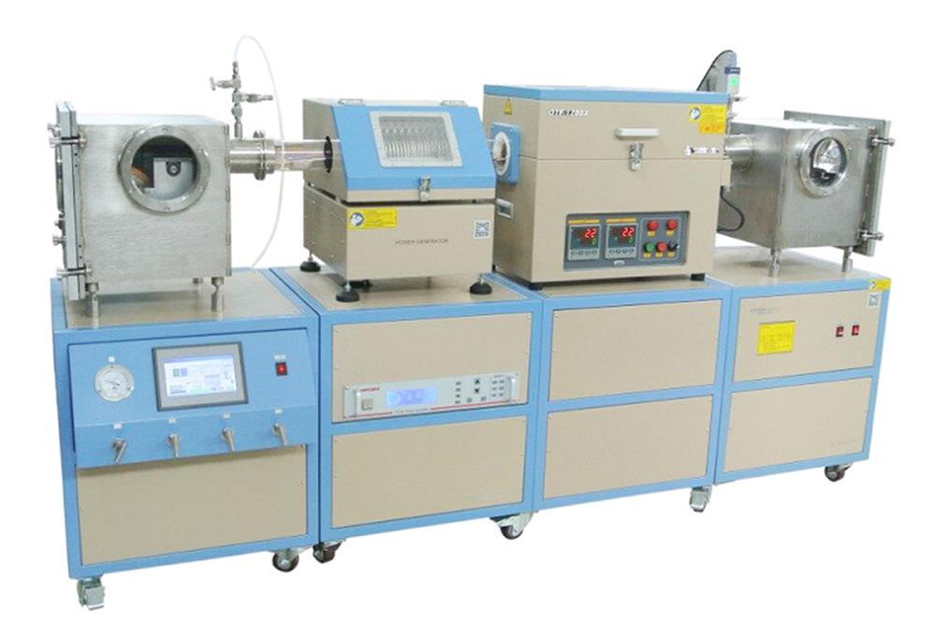
Notes:
My graduate group used three different techniques: PLD, UHV-PLD and CVD. PLD and CVD provided similar quality, but not has good as UHV PLD. But not trivial to transfer the recipe from chamber to chamber.
In CVD, heat is used to decompose the gas rather than a plasma source (compare with sputtering or glow-discharge)
CVD is relatively easy to industrialize
Chemical vapor deposition (CVD) is a chemical process used to produce high quality, high-performance, solid materials. The process is often used in the semiconductor industry to produce thin films. In typical CVD, the wafer (substrate) is exposed to one or more volatile precursors, which react and/or decompose on the substrate surface to produce the desired deposit. Frequently, volatile by-products are also produced, which are removed by gas flow through the reaction chamber. A disadvantage is that you have to figure out the precursors, which isn’t always obvious by chemistry. I may also not be as easy to grow smoothly, depending on the material.
Atomic layer deposition (ALD) is a thin film deposition technique that has gained in popularity recently. I don’t know much about it so I can’t tell you if that popularity is warranted. ALD is based on the sequential use of a gas phase chemical process. ALD is considered a subclass of chemical vapour deposition. The majority of ALD reactions use two chemicals, typically called precursors. These precursors react with the surface of a material one at a time in a sequential, self-limiting, manner. Through the repeated exposure to separate precursors, a thin film is slowly deposited. ALD is a key process in the fabrication of semiconductor devices, and part of the set of tools available for the synthesis of some nanomaterials.

Slide 31
Atomic Layer Deposition (ALD)
Nice video: https://youtu.be/HUsOMnV65jk
An advantage of ALD is the ability to coat complex items while maintaining quality.
More expensive and tricky than sputtering.
More chemical involvment
Generally, a trade off between ease and quality.
Notes:
Recent development

Slide 32
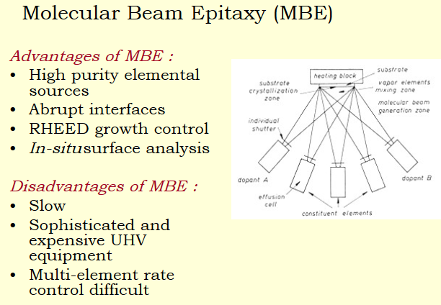


Slide 34
Great for semiconductors and topological insulators

Slide 35
Great for semiconductors and topological insulators

Slide 36

(or Laser)

Slide 37
(or Laser)

Slide 38
(or Laser)

Slide 39
(or Laser)

Slide 40
(or Laser)

Slide 41
(or Laser)

Slide 42
(or Laser)
Rotating the target and/or substrate improves uniformity

Slide 43


Layer-by-Layer Growth Techniques
Laser (often 248 nm)
Electron Detector
Substrate
Electron Gun
MBE
Target(s)
Laser
Pulsed Laser Deposition (PLD)

Slide 44
Both MBE and PLD use RHEED to optimize
(Reflection High Energy Electron Diffraction)
Laser (often 248 nm)
Substrate
Electron Detector
Electron Gun
MBE
Target(s)
Laser
Pulsed Laser Deposition (PLD)

Slide 45



Reflection High Energy Electron Diffraction (RHEED)
Notes:
But the same could be said for making weapons before they were automated.

Slide 46
Reflection High Energy Electron Diffraction (RHEED)
Notes:
But the same could be said for making weapons before they were automated.

Slide 47
Reflection High Energy Electron Diffraction (RHEED)
Sample growth with MBE or PLD is sometimes referred to as an art. Every chamber is different. Have to optimize!
Notes:
But the same could be said for making weapons before they were automated.

Slide 48

Material Growth Modes
Some materials rather clump together.
Others form flat layers. Some in between.
Notes:
You can roughly think about it as depending on whether the atoms would rather bond to the substrate or itself. The real quantity to look into would be the surface energy, but that’s not something we are really going into in this class.

Slide 49


