Slide 1
Magnetic Data Processing
I forgot that I planned to talk about how to give a good talk today, so I’ll let you pick between two options today:
Magnetic Data Processing
and/or
How to Make and Give a Good Talk
Could do one of these next time.
December 1 is our last class. I want you to talk about whatever you have done with the data. And for Brooke and Haley, what you want to try next semester.
What do we do with the raw data?
Since our data is currently a bit more limited than I expected, let’s get into the processing a bit more than we might have had time for otherwise.

Slide 2
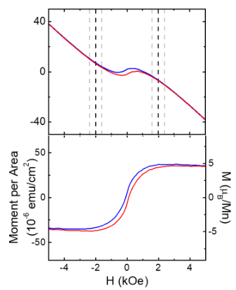
Why do we need to process it at all?
Remember that the vibrating sample magnetometer (VSM) system gives total magnetization.
This includes the substrate, which will have some type of magnetism.
It is also not normalized for volume.
First we subtract the substrate signal.
Raw Moment (emu)
a)
b)

Slide 3
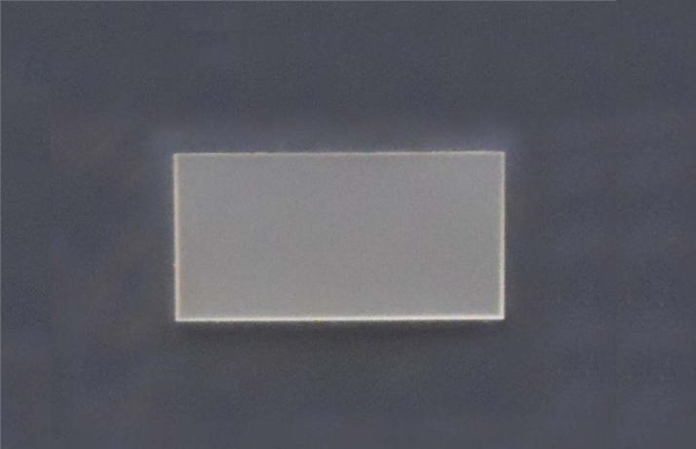
Why background subtract this way?
You could ask why we don’t have a control sample that we subtract from this signal.
We have tried it. My past magnetism student said it varies a little from substrate to substrate. According to him, we get better looking results from subtracting the linear part out.
LAO substrate
It’s not uncommon for us to cut our substrates in half. Gives us twice as many substrates, but will lead to small variations.

Slide 4
How exactly do you subtract?
Anyone try it yet? What did you try?
We have two lines. Would it be better to use just one?
Should they have the same slope?
Where should we cut out the data? Do we even need to?
Like most of my approaches to scientific data analysis, I’d try it both ways. See how it affects the data. If not much, probably both are fine. If it does, then I have to think about which makes more sense. Maybe consult with an expert.
Raw Moment (emu)

Slide 5
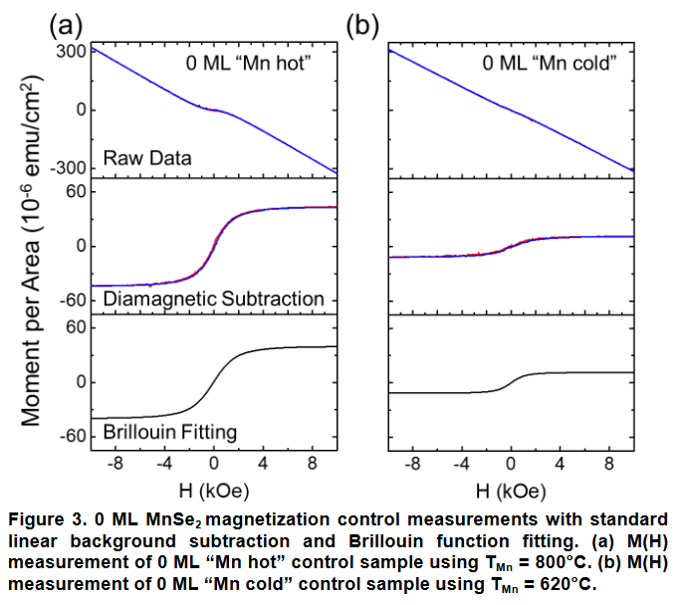
At the time, we didn’t realize this was magnetic competition
This assumes that all of our diamagnetic contribution comes from the substrate. That may not be the case. Perhaps it would be worthwhile to double check the variation and mull over if there is a better way.
If we wanted to background subtract with the substrate, we’d have to do all of the MvsH measurements at all of the same temperatures as our actual measurements.
I remember it didn’t work well the first time and we assumed maybe because of the heating introduced during growth.

Slide 6
For my proposal, I’d love a figure that looked like this more or less
No vertical dotted lines please
Please include the initial magnetization, likely as a different color (I like red). It’s not necessary to color these two different colors, but I do think it looks nice. Maybe blue and a dark rusty gold color for WVU, but also dark enough it shows up?
Do line up the x axes, can be done in Origin, or combined later in something like Microsoft paint
Note this second right axis (only for the second graph). I still need to tell you how to do this.
Raw Moment (emu)
From the paper I emailed you: https://arxiv.org/ftp/arxiv/papers/1807/1807.01348.pdf

Slide 7
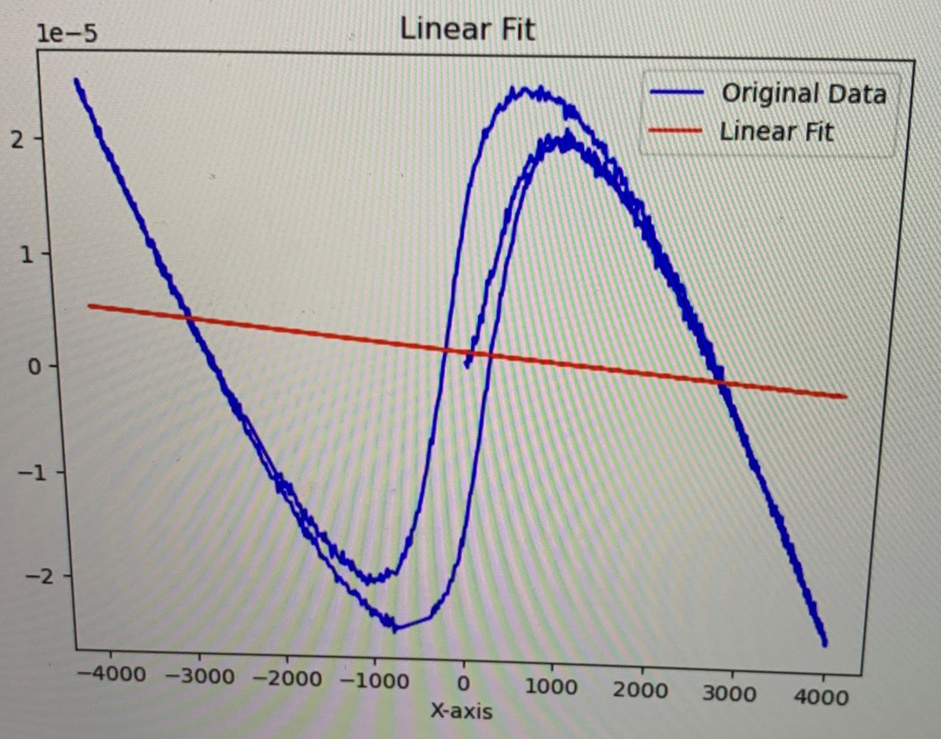
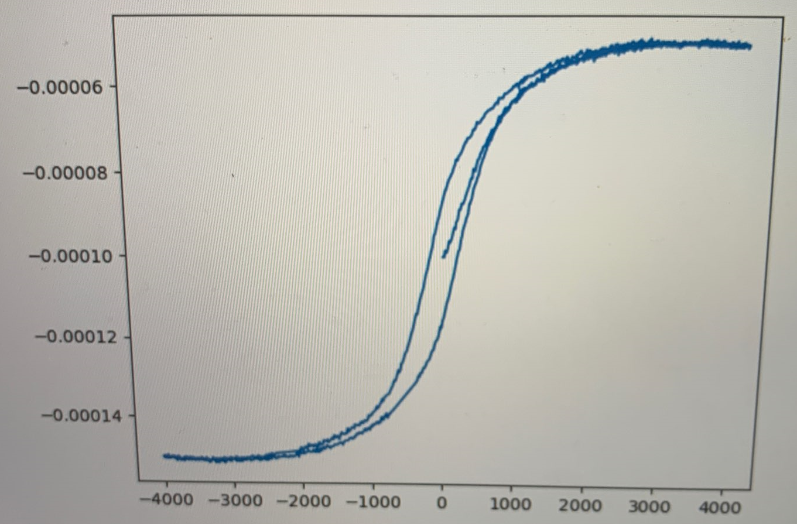
Linear fit if you don’t subtract the middle. Fit the tails
Shape Fixed
Applied Magnetic Field (Oe)
Applied Magnetic Field (Oe)
Anything else seem weird?
This area should be flat
Notes:
Should start at zero, need to normalize too

Slide 8
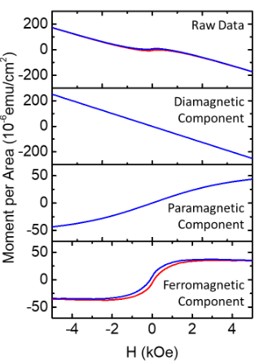
If the loops don’t saturate (flatten out), a simple subtraction may not be enough.
Raw Moment (emu)

Slide 9
Normalizing for volume
We need to know the film thickness and the sample length and width
We know thickness from oscillations during growth and/or XRR measurements
Sample surface area is 5 x 10 mm^2, thickness 84 uc.
LAO substrate

Slide 10
What’s that right hand side?
You’ll note in the lower one, there are actually two different y axes. You don’t necessarily have to do this, but doing both is the best way to plot magnetization. The right one gives you a better idea of what you’d expect.
Let’s discuss it at least.
Raw Moment (emu)
a)
b)

Slide 11
Bohr magneton μ_{B} is a constant = 9.274 x 10⁻²⁴ J/T = 9.274 x 10⁻²¹ emu = eh/2m_{e}, m_{e}=electron mass
(10,000 Oe=1T)
The erg is a unit of energy and work equal to 10⁻⁷ joules. It originated in the centimeter–gram–second (CGS) system of units.
Our magnetometer measures the total magnetic moment of your sample in units of erg/G (emu). If you divide this value by μ_{B} = 9.2741 × 10⁻²¹ erg/G (emu) you get the total number of Bohr magnetons of your sample.
To get per Mn, we need to figure out how many Mn are our sample. How should we do that?
Sample surface area is 5 x 10 mm^2, thickness 84 uc. 84 Mn high or related to that?
How about how many Mn in one atomic layer?

Slide 12
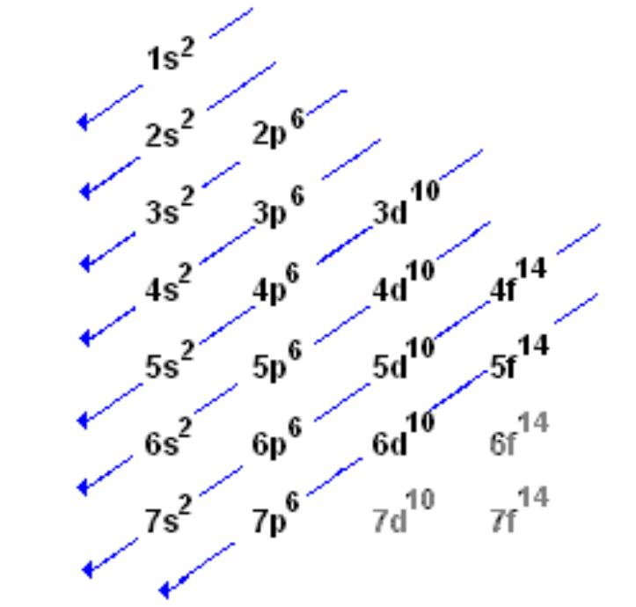
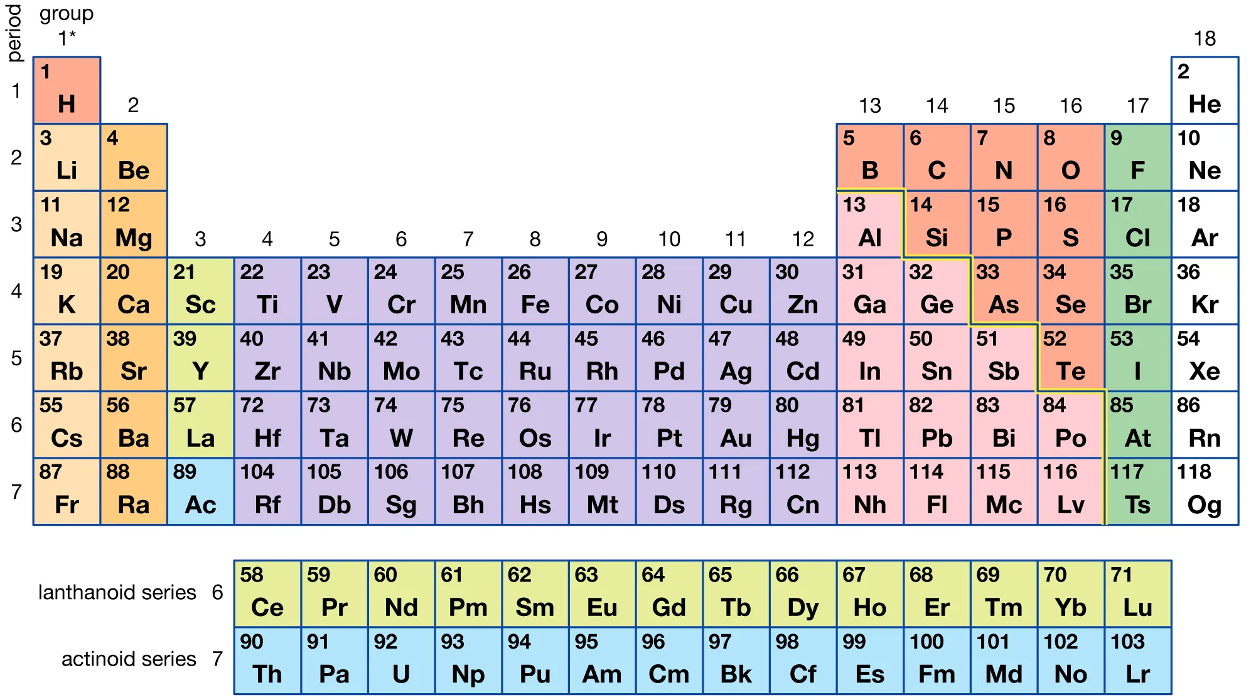
What do we expect?
It depends on the material.
We are working with LaMnO₃.
The magnetic element is Mn. Any idea why the other elements are not contributing to the magnetism?
Notes:
The calculated magnetic moment (MM) value was 2.0 μ_{B}. This result is in agreement with the characteristic of half-metallic systems, which MM corresponds to an integer value for effective number of Bohr magneton. (Source: https://www.sciencedirect.com/science/article/pii/S0304885308000620)

Slide 13
Electron configuration fills up the lowest energies first
A perfectly ferromagnetic film would give 2.0 μ_{B.} Do we expect it to be perfect?
Notes:
Nah, it won’t get up to 2.

